Slide 1
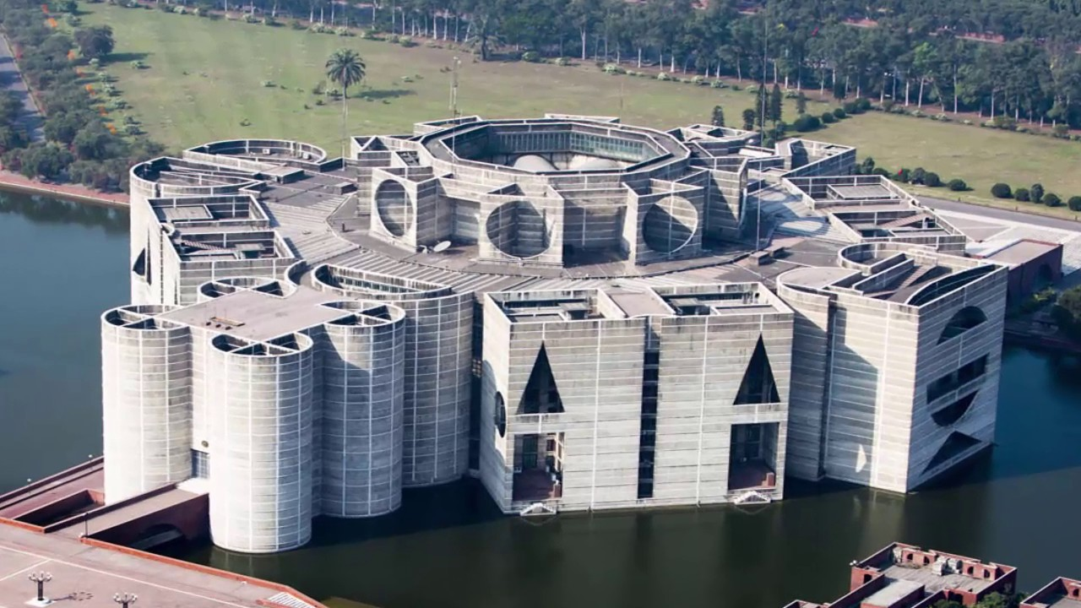
Bangladesh North Plaza Parliament Presidential Lobby & Office
Toshiba VRF-630 Ton

Slide 2
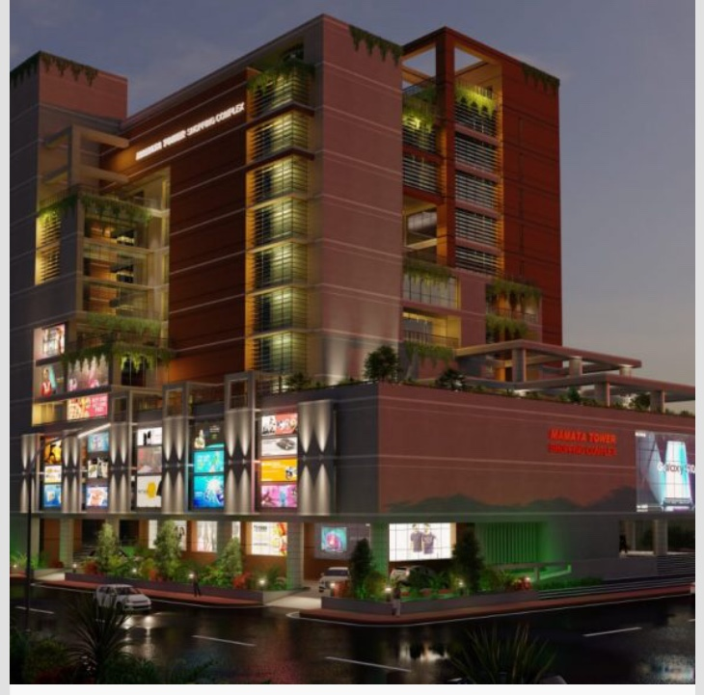
Mamata Tower Shopping Complex
Toshiba VRF-578 Ton

Slide 3
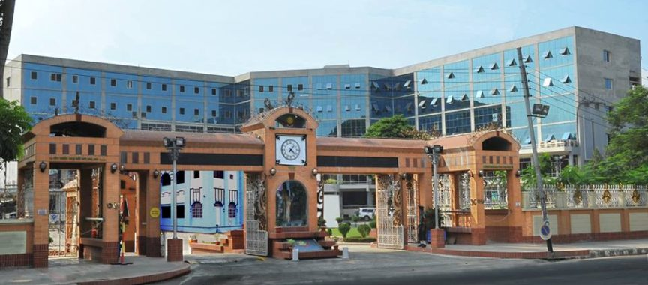
Dhaka Metropolitan Police Head Quarters
Toshiba VRF-455 Ton

Slide 4
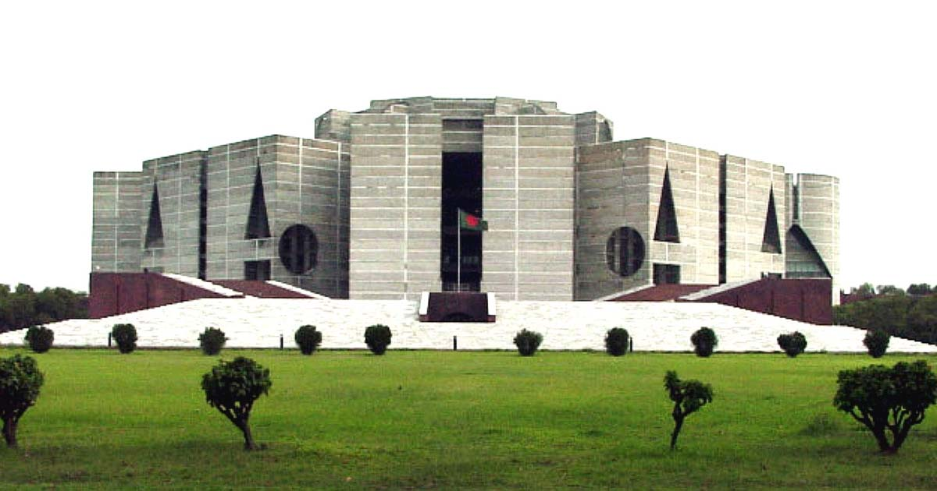
Bangladesh National Parliament Medical Center
Toshiba VRF-89 Ton

Slide 5
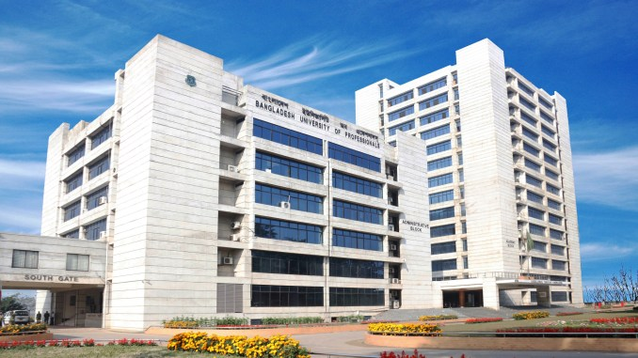
Bangladesh University Of Professionals
Toshiba VRF-70 Ton

Slide 6
Bangladesh National Parliament Member’s Building & MP Hostel
Toshiba VRF-140 Ton

Slide 7
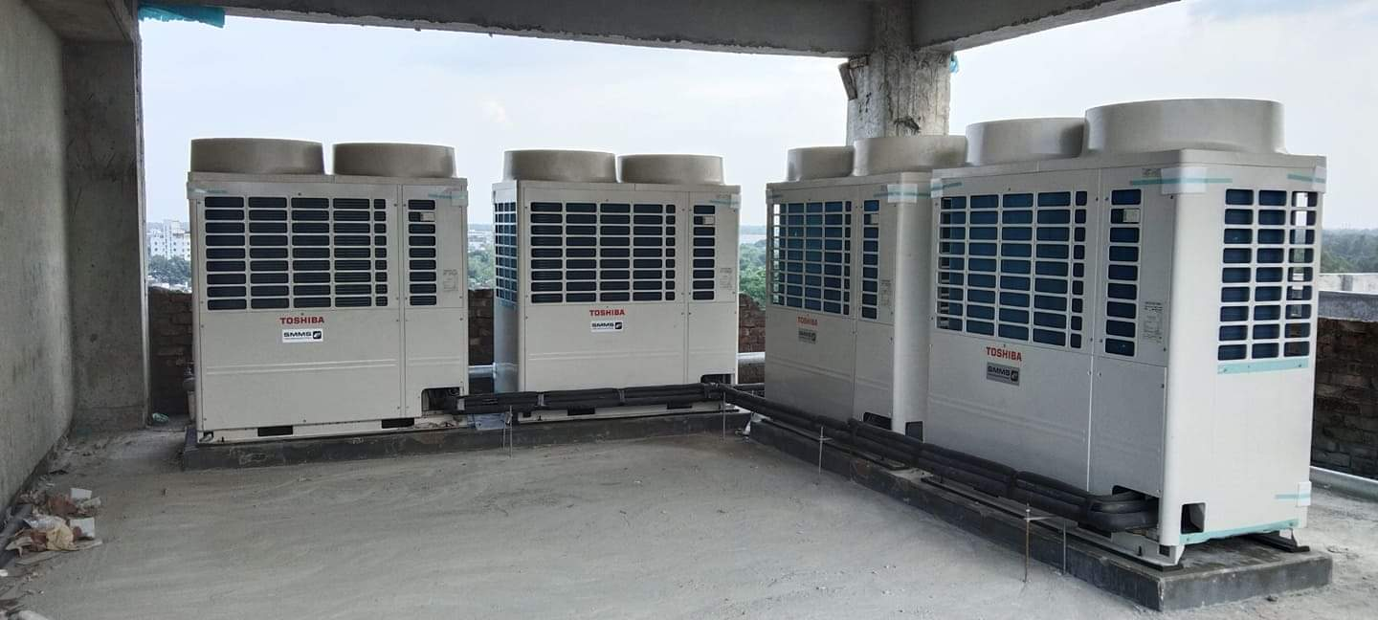
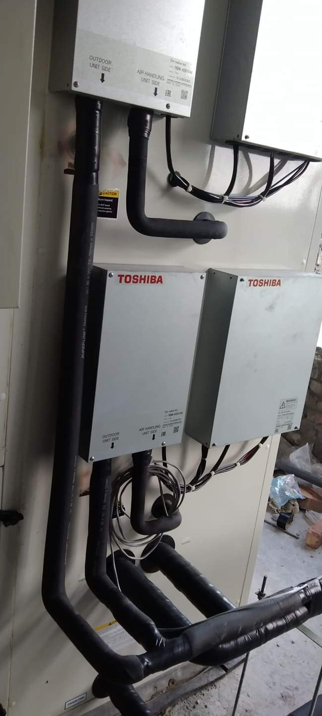
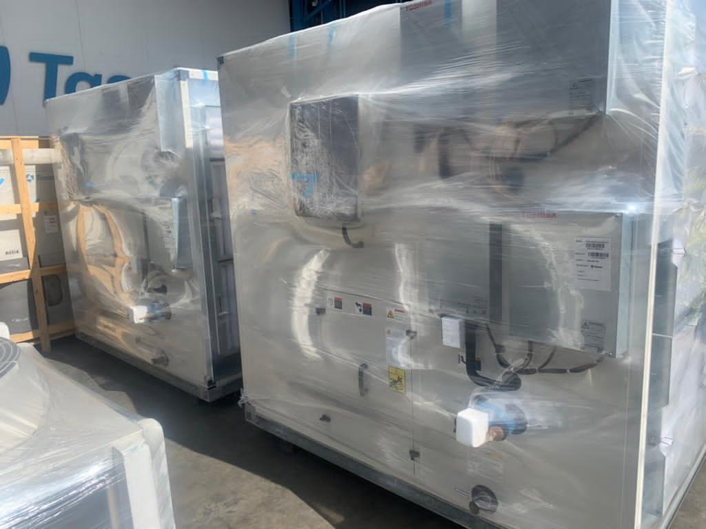
Bogra Hospital
Toshiba VRF & AHU-89 Ton

Slide 8
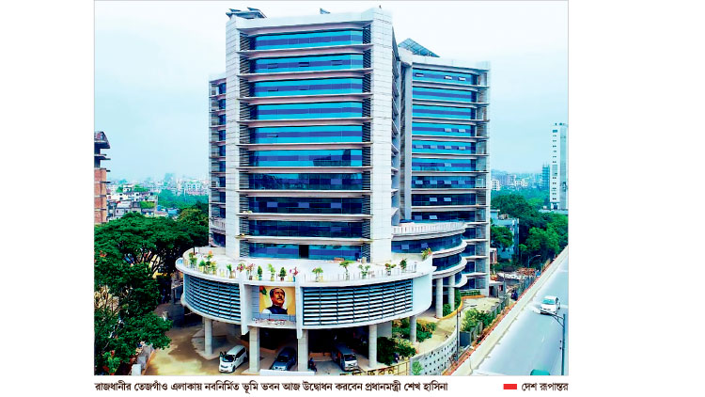
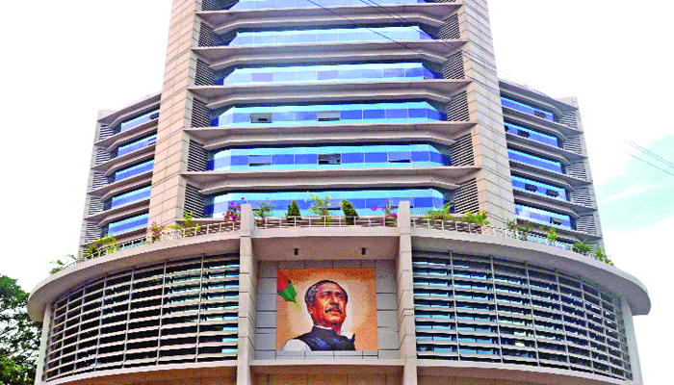
Bhumi Bhaban Complex
Toshiba VRF-420 Ton

Slide 9
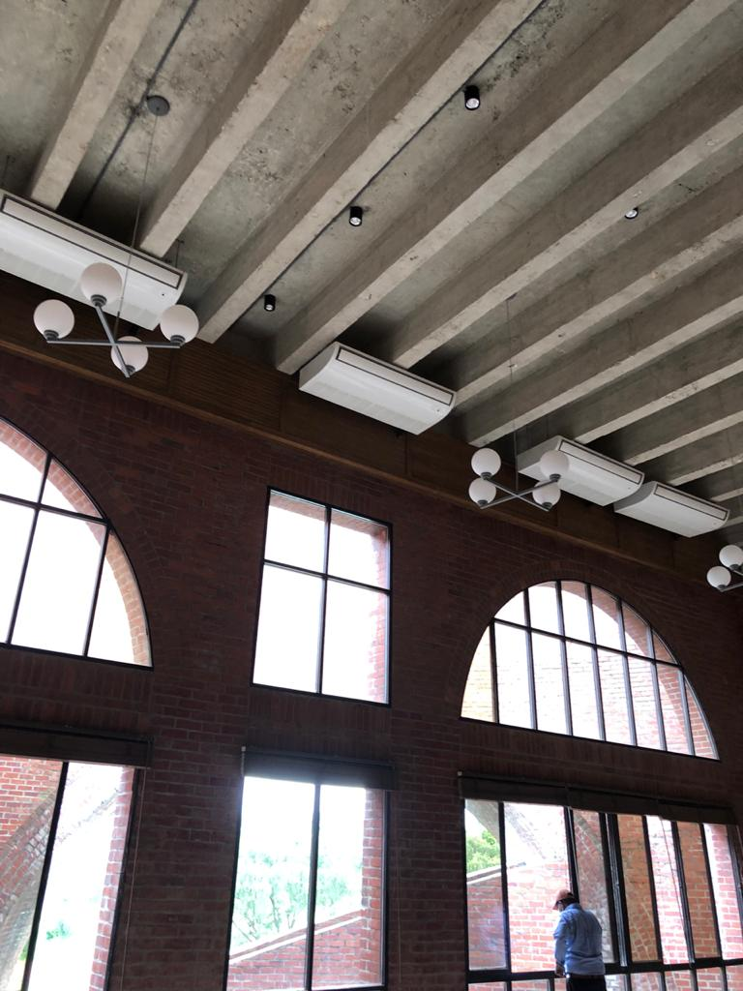
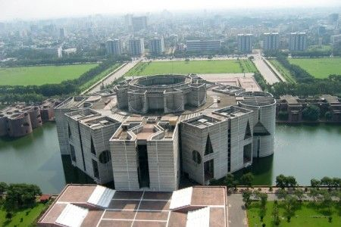
Bangladesh National Parliament Member’s Club & Community Hall
Toshiba VRF-298 Ton

Slide 10
National Institute of Mental Health And Hospital
Toshiba VRF-175 Ton

Slide 11
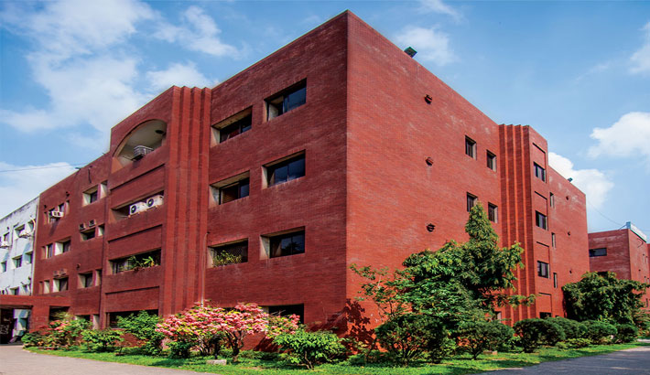
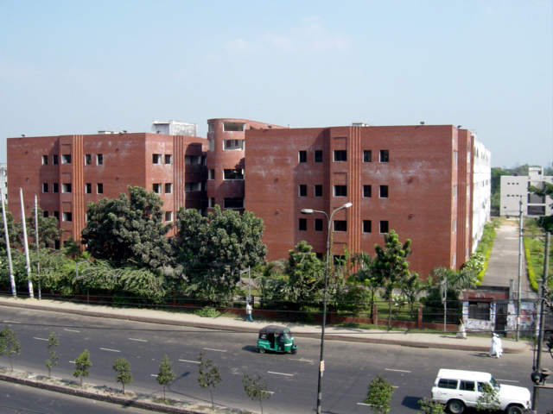
National Institute of Kidney Diseases & Urology(NIKDU)
Toshiba VRF-192.50 Ton

Slide 12
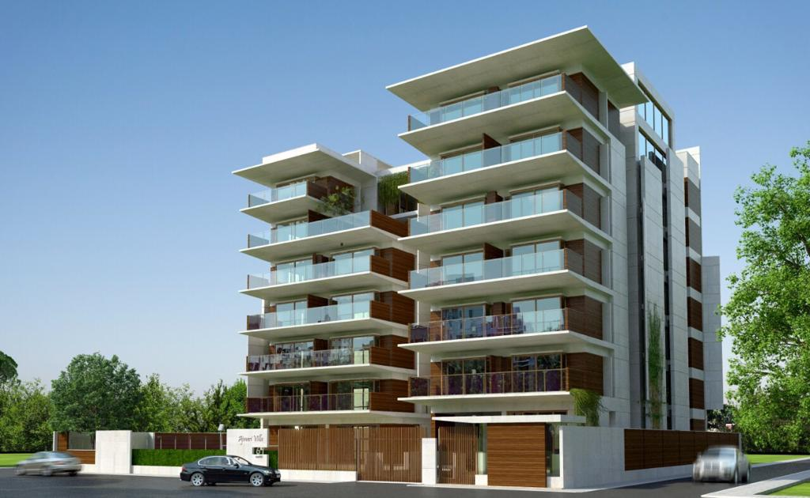
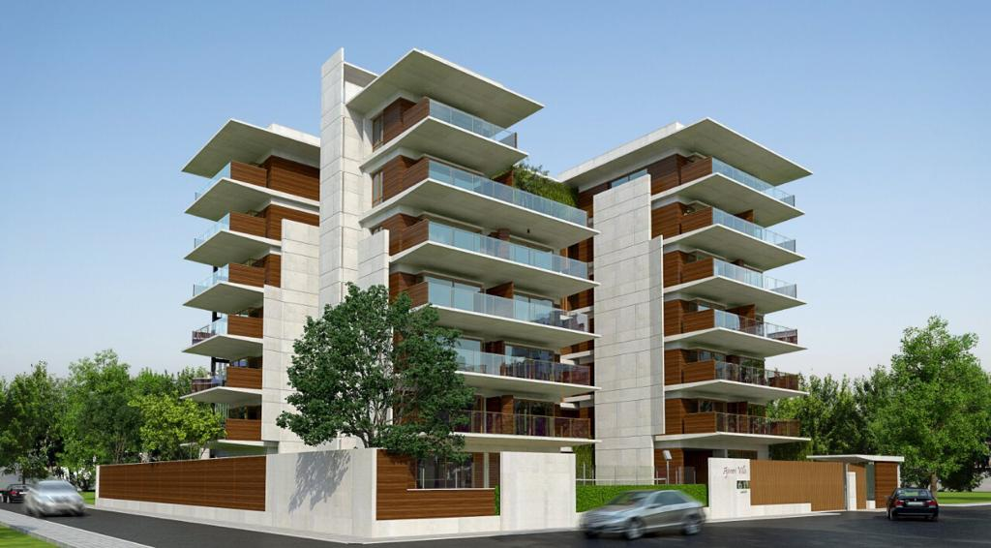
Kayes Residence Apartment
Toshiba VRF-133 Ton

Slide 13
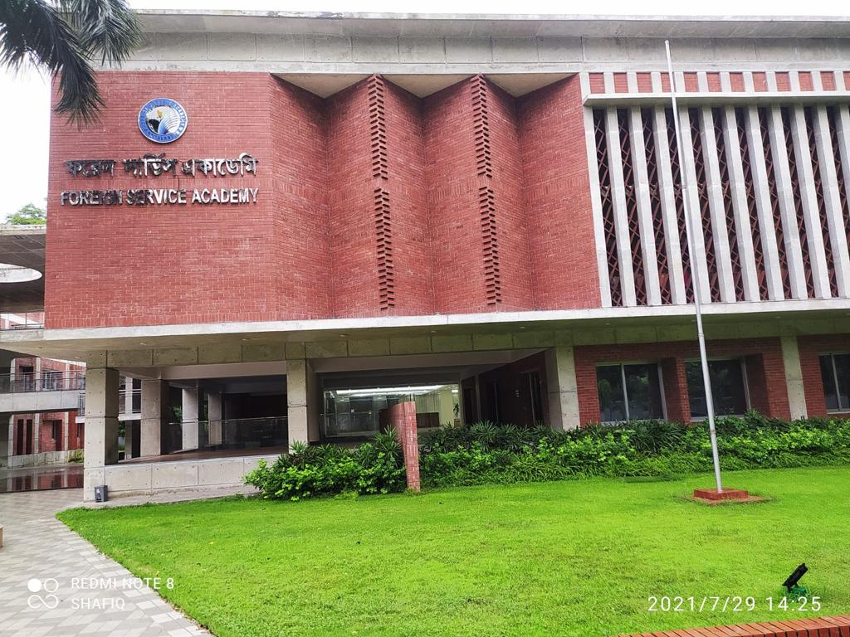
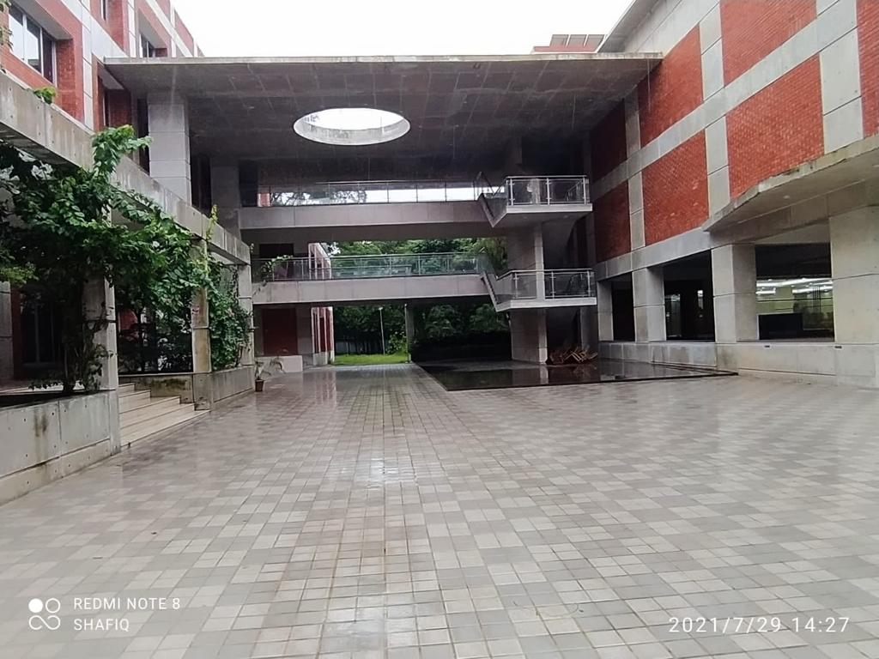
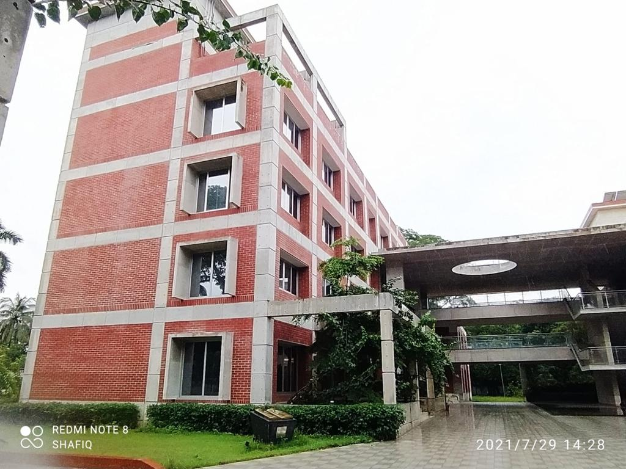
Foreign Service Academy
Toshiba VRF-210 Ton

Slide 14
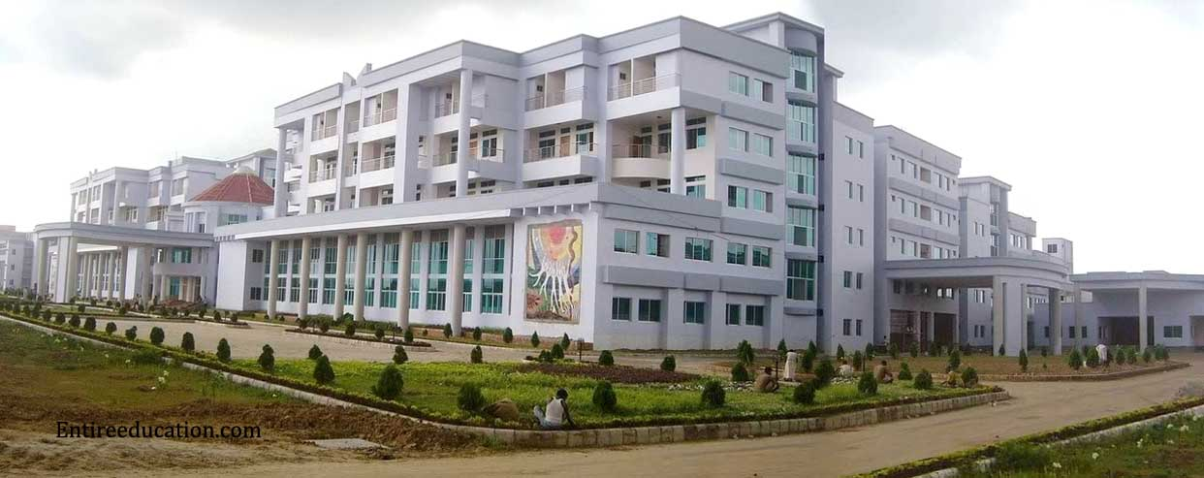
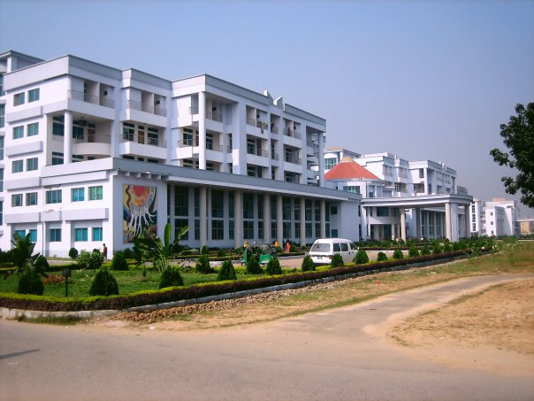
Shahid Ziaur Rehman Medical College, Bogra
Carrier Ducted-146 Ton

Slide 15
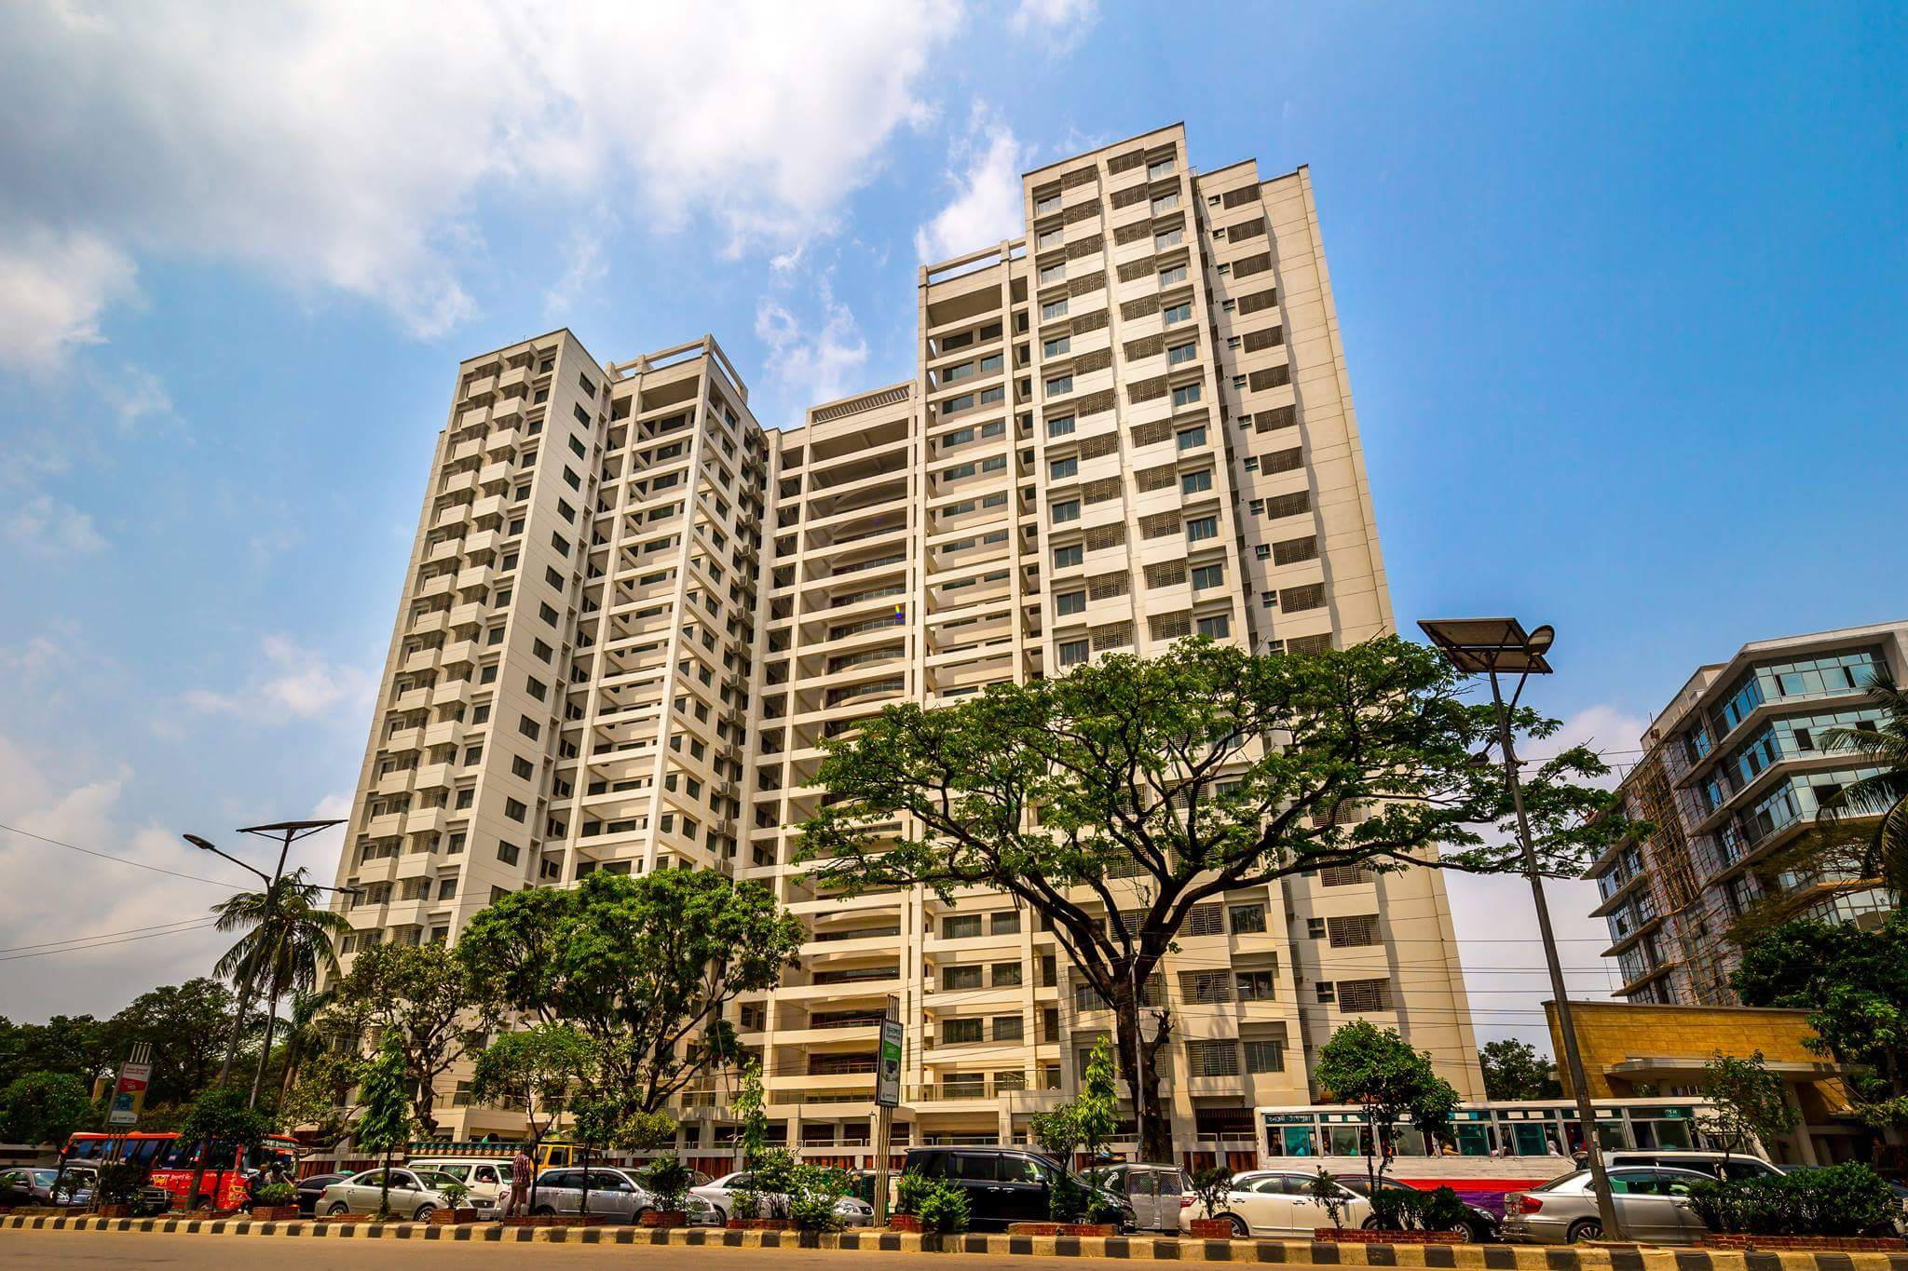
Justice Complex
Carrier Residential and Light Commercial-550 Ton

Slide 16
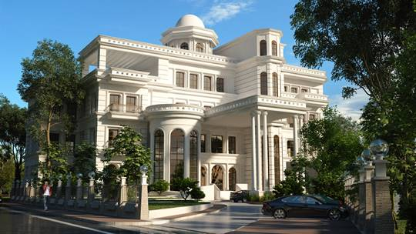
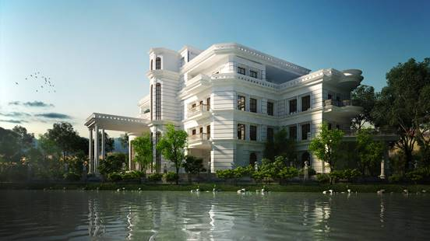
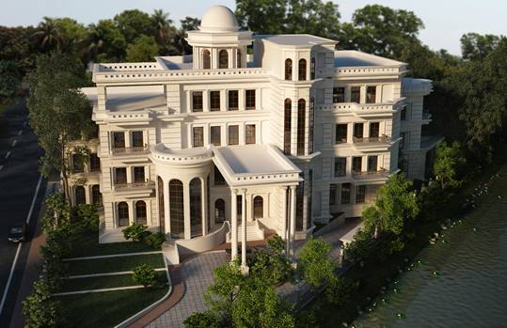
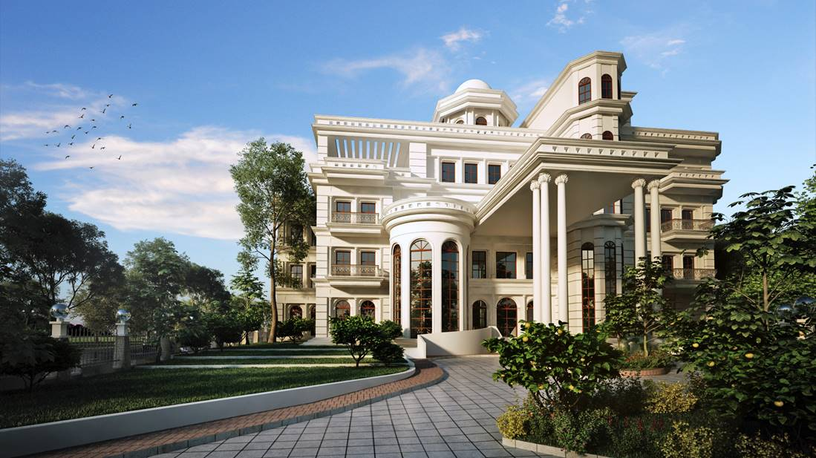
Villa
Toshiba VRF-157 Ton

Slide 17
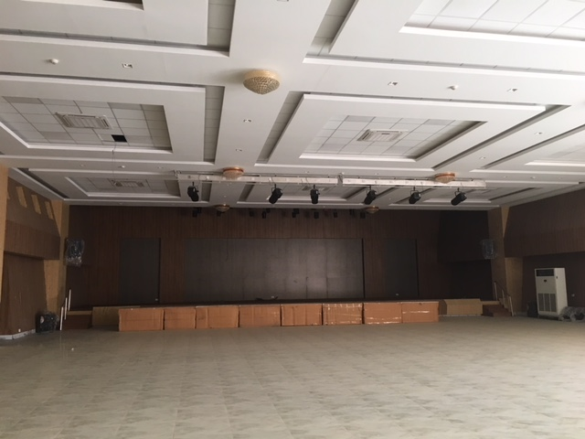
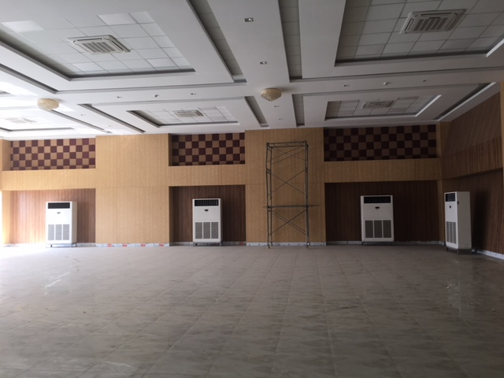
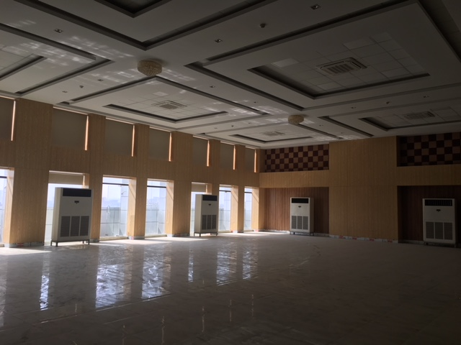
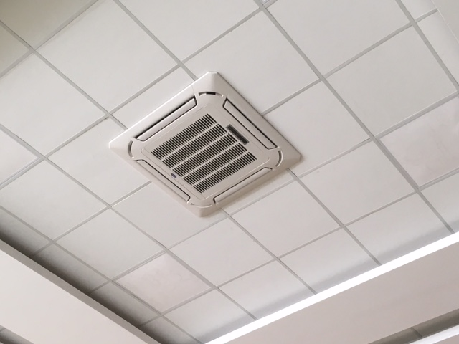
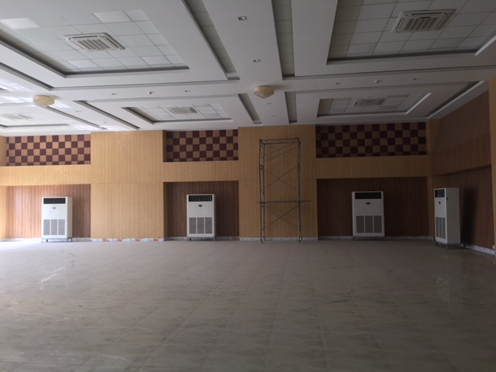
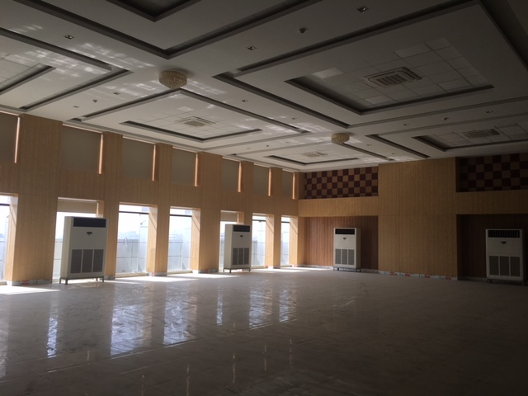
Cooperative Society building
Carrier Residential and Light Commercial-250 Ton

Slide 18
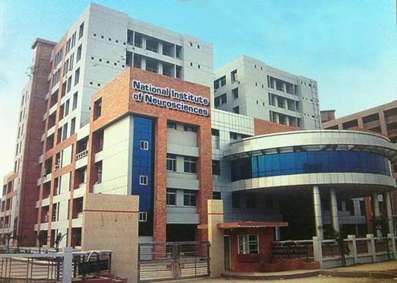
National Institute of Neuro Science
Toshiba VRF-158 Ton

Slide 19
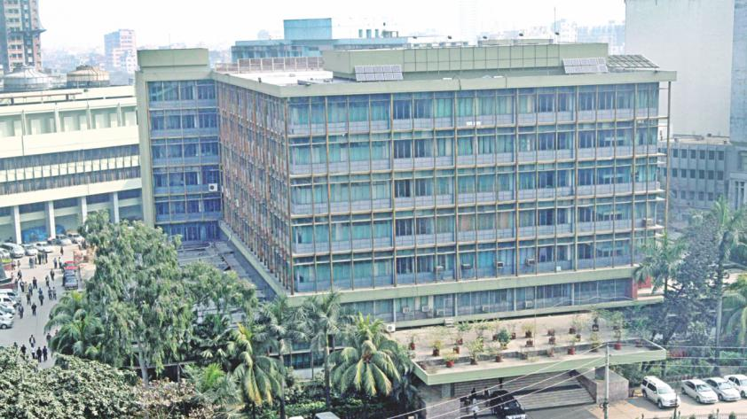
Bank
Carrier Under Ceiling-208 Ton

Slide 20
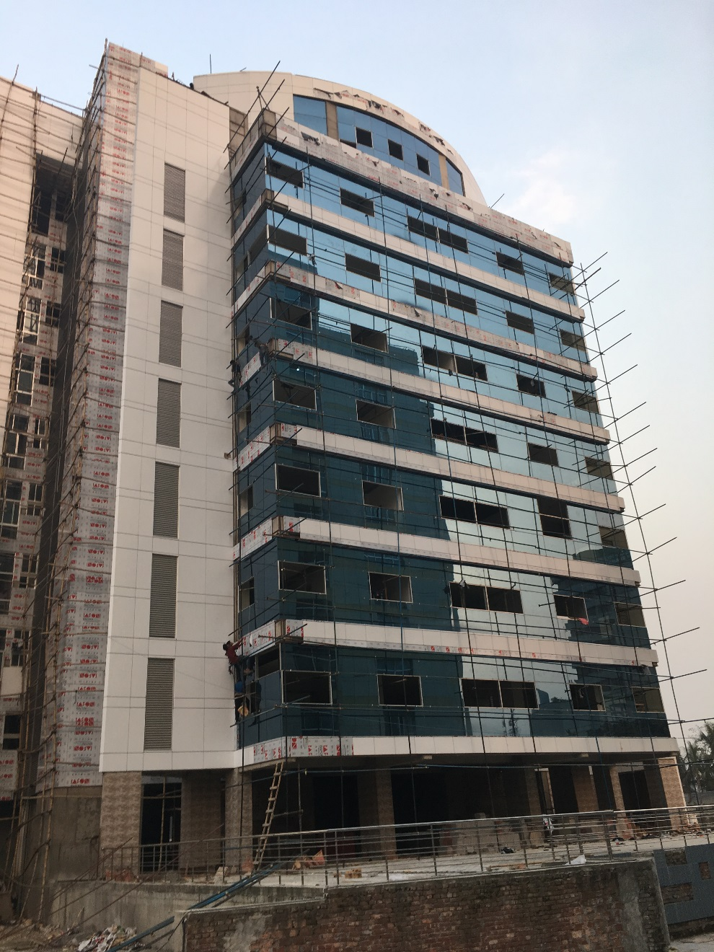
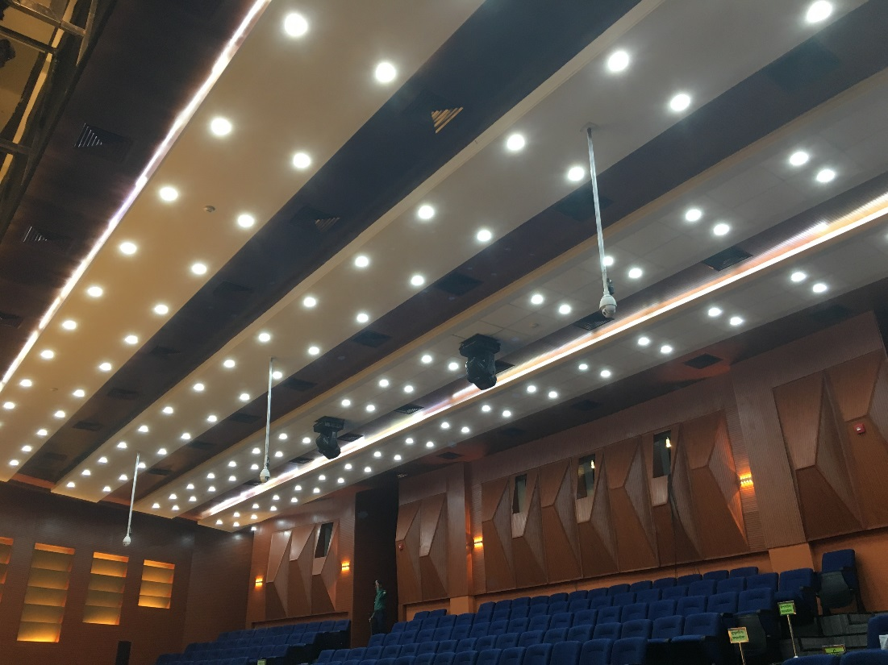
Election Commission
Toshiba VRF-455 Ton

Slide 21
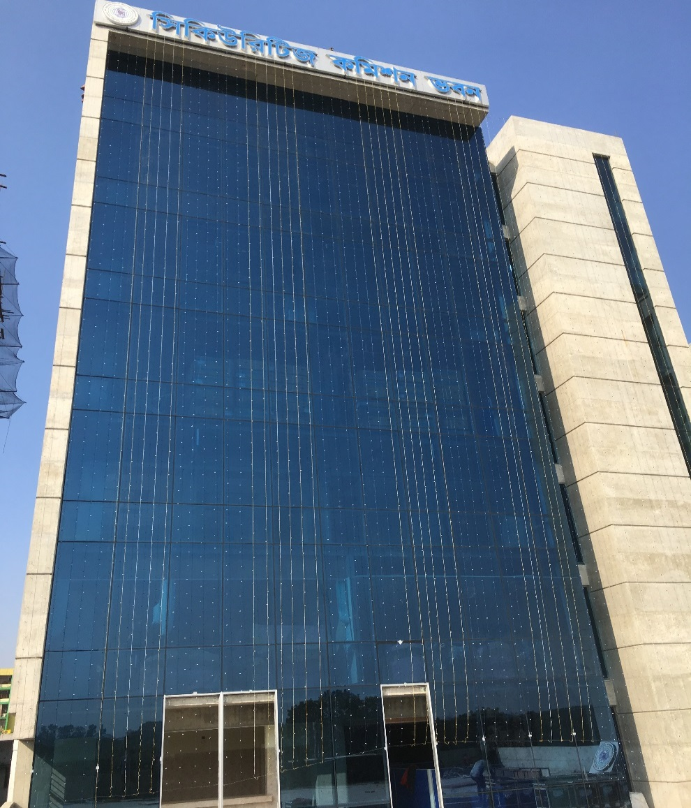
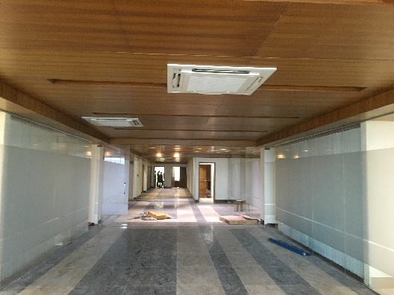
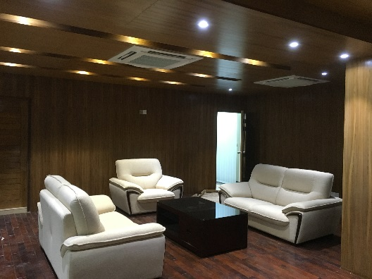
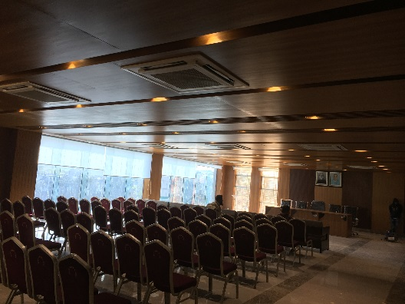
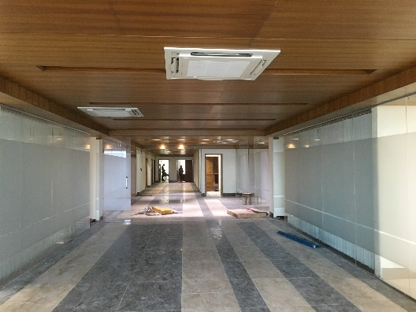
Security Exchange Commission
Toshiba VRF-490 Ton

