Slide 1


Slide 2

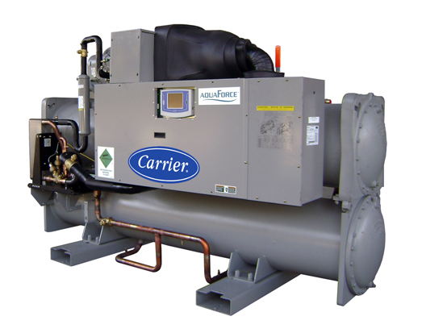
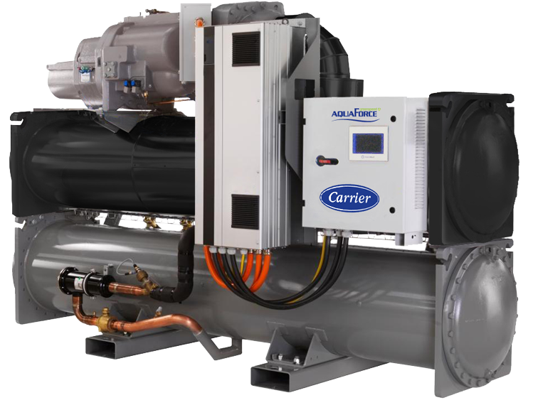
30% Energy Saving
Now available from India
150 TR ~ 350 TR AHRI Certified
Improving Plant Room Efficiency.
Case Analysis :
AquaForce® 30XW-V Variable Speed
Screw Chiller & 30XW Fixed Speed Premium Efficiency Screw Chiller
Carrier Comfidential and Proprietary

Slide 3
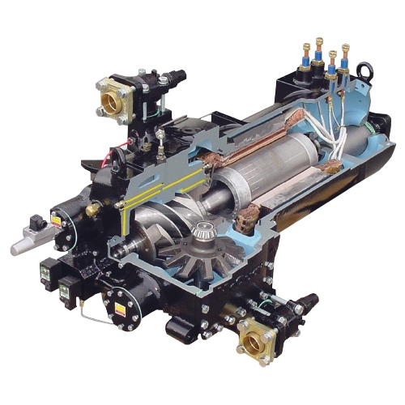
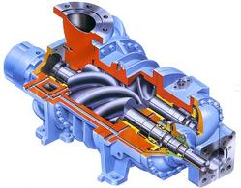
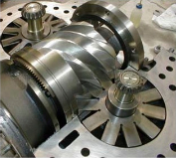
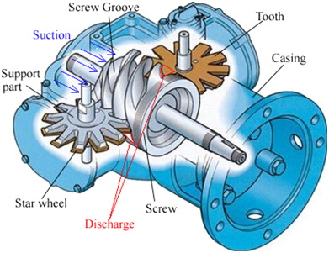
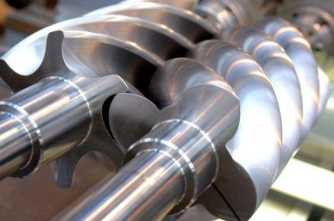
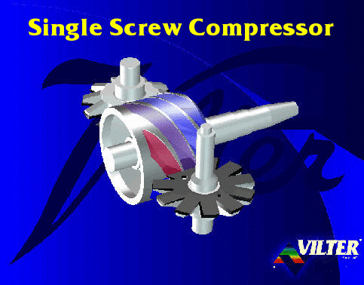
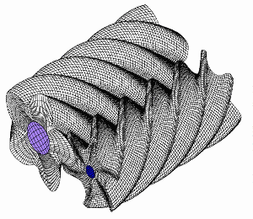
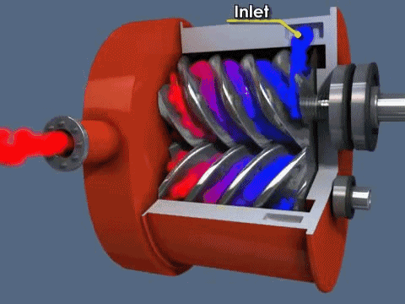
Advantages of Carrier Chillers – Twin Screw Technology
Mono Screw Compressor
Modern - Twin Screw Compressor

Slide 4
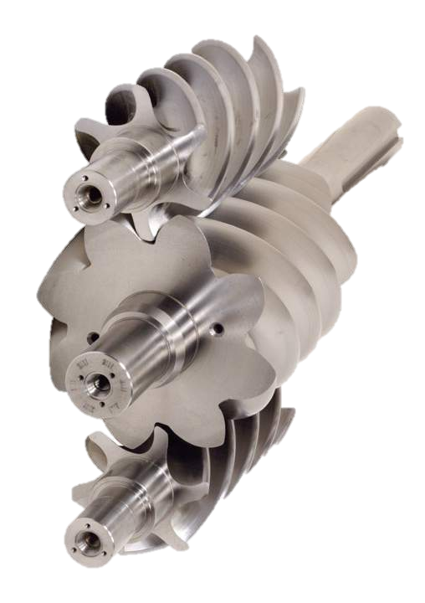
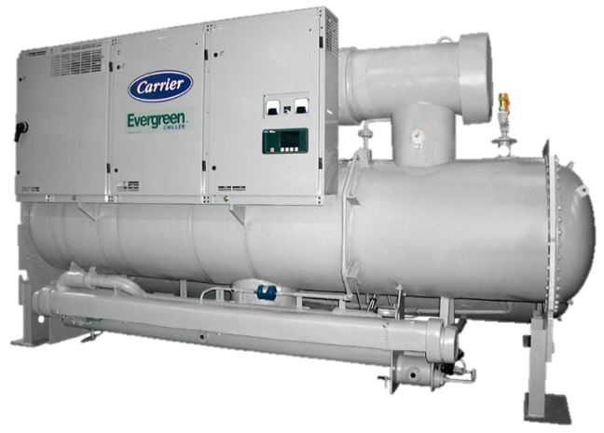
IPLV – 0.32 KW/TR
Exceeding Performance
Water Cooled
23XRV- Tri-Rotor Screw Chiller
Carrier Comfidential and Proprietary

Slide 5
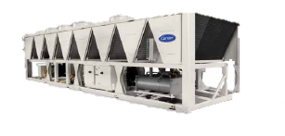
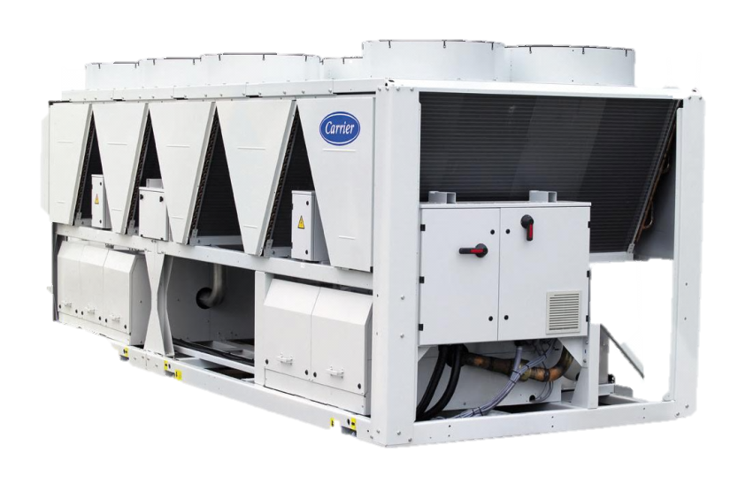
AIR Cooled SCREW Chillers
Now available from India
Full range 80 TR – 400 TR
AquaForce® 30XA-V Variable Speed
30XA Fixed Speed Screw Chiller
Carrier Comfidential and Proprietary

Slide 6
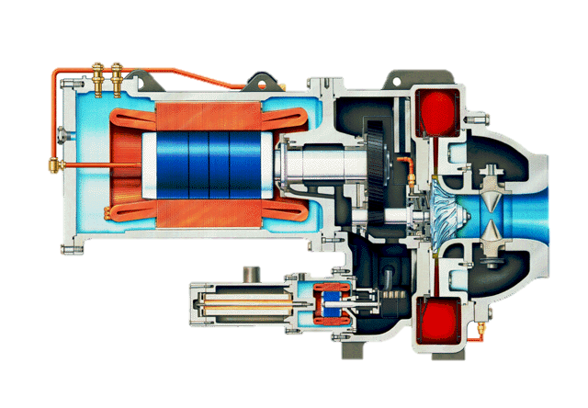
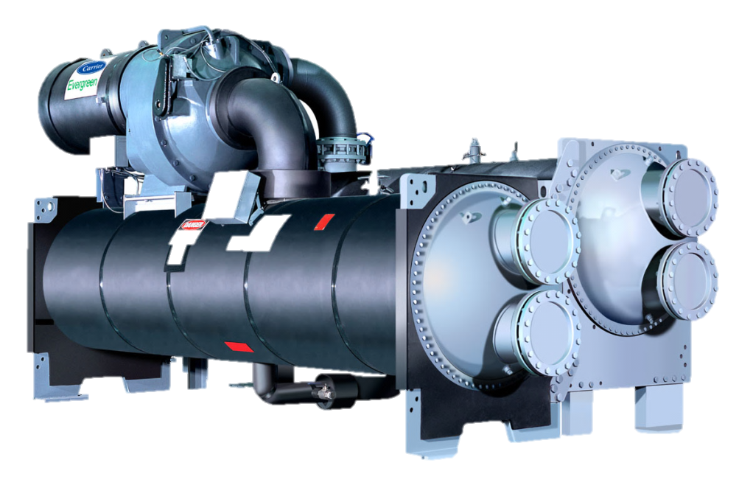
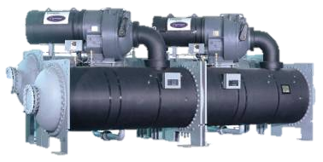
Centrifugal Chillers – 350 – 3000TR
19XR, 19XR-V, 19XRD
HT & LT
Carrier Comfidential and Proprietary

Slide 7
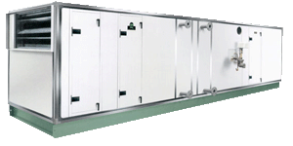
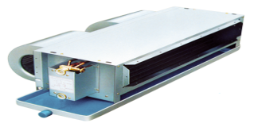
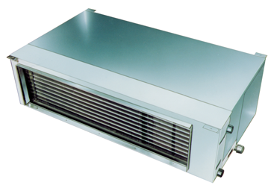
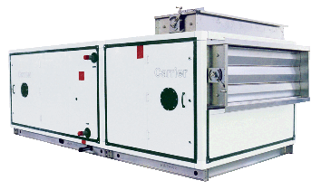
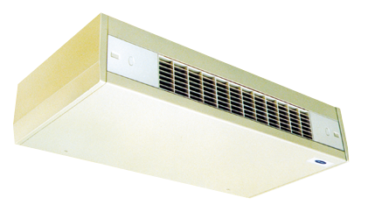
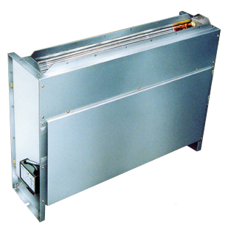
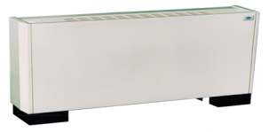
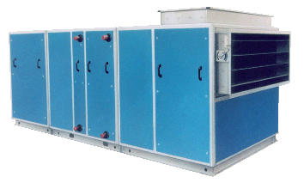
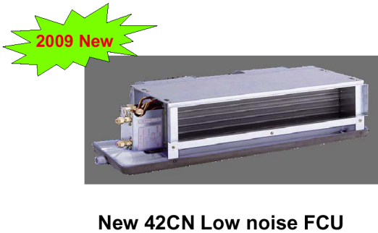
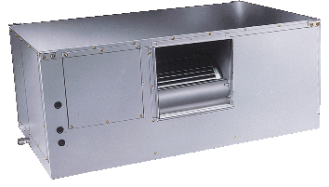
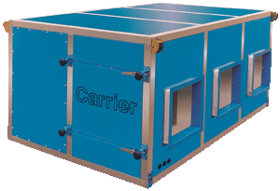
Airside products
AIRHANDLING UNITS
FAN COIL UNITS
39XT
Air volume:
2,000~200,000m³/h
39CBF
42 CE
Conceal
(horizontal)
42 CW/CH
High pressure
Large air volume
42 GWC
Cassette
Air volume:
2,000~200,000m³/h
39G
Air volume:
2,000~200,000m³/h
42 CL
Cabinet
(horizontal)
42 VL
Cabinet
(vertical)
42 VM/VP
Conceal
(vertical)
DBFP
BFP
Air volume:
2,000 ~36,000m³/h

Slide 8

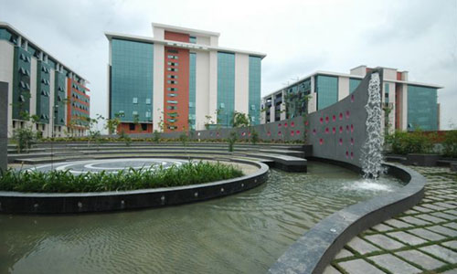
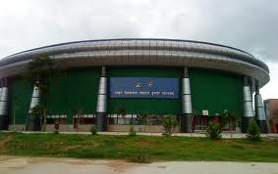
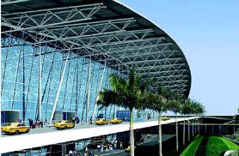
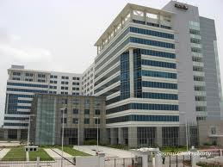
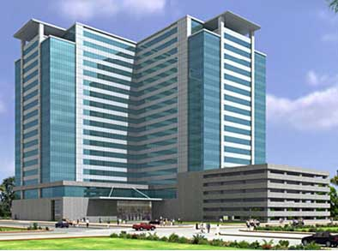
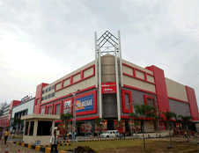
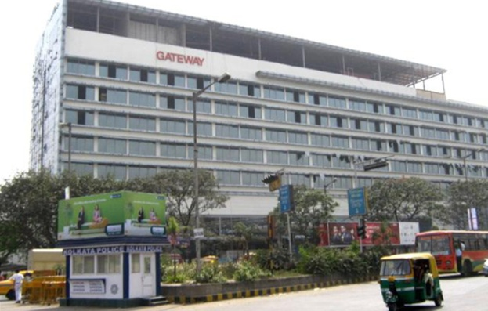
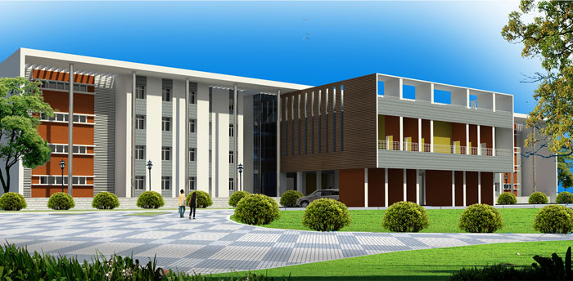
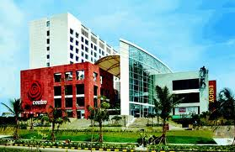
Prestige Installations of East
Ecospace, Rajarhat
DLF Kolkata
TAJ Gateway, Kolkata
Ranchi Stadium
Godrej Genesis, Kolkata
NIT Rourkela
Kolkata Airport
City Center - Raipur
City Center-II & Swissotel

Slide 9
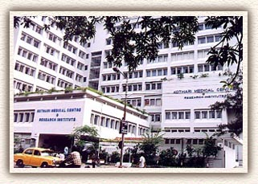
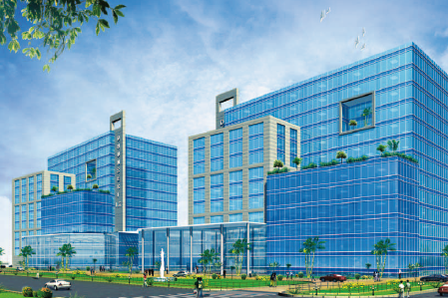
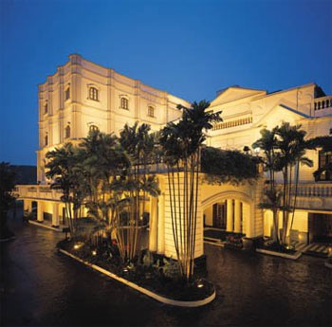
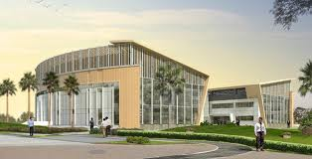
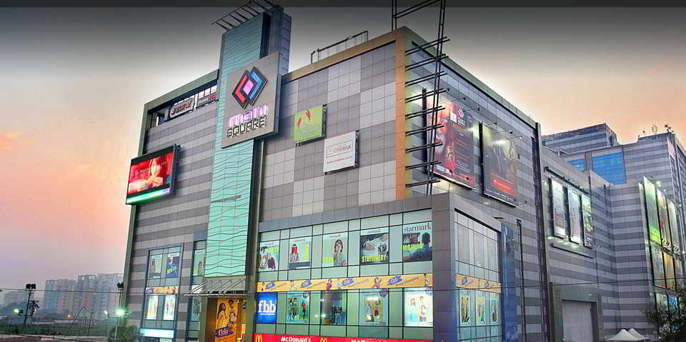
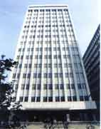
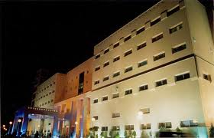
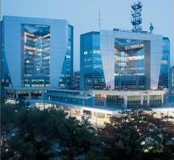
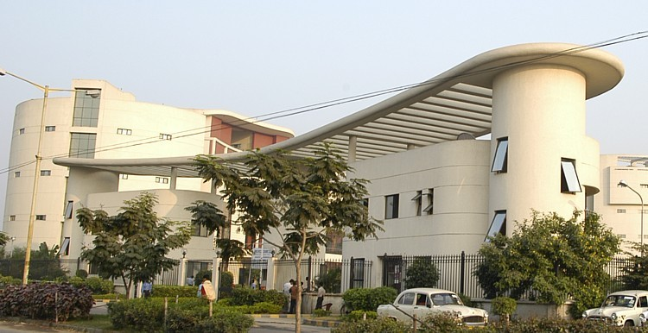
Prestige Installations of East with Centrifugal Chillers
Kothari Hospitals
RMZ TCS Office
Apollo Gleagles, Kolkata
Dhunseri IT Park
Mani Square, Kolkata
Infinity , Kolkata
Oberoi Grand, Kolkata
Birla Building, Kolkata
Wipro IT Park

Slide 10
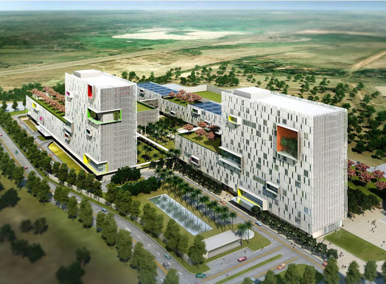
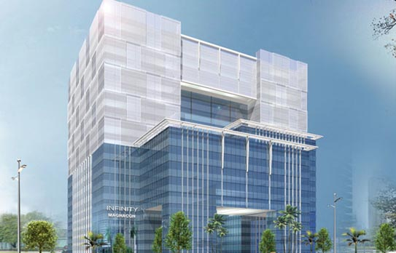
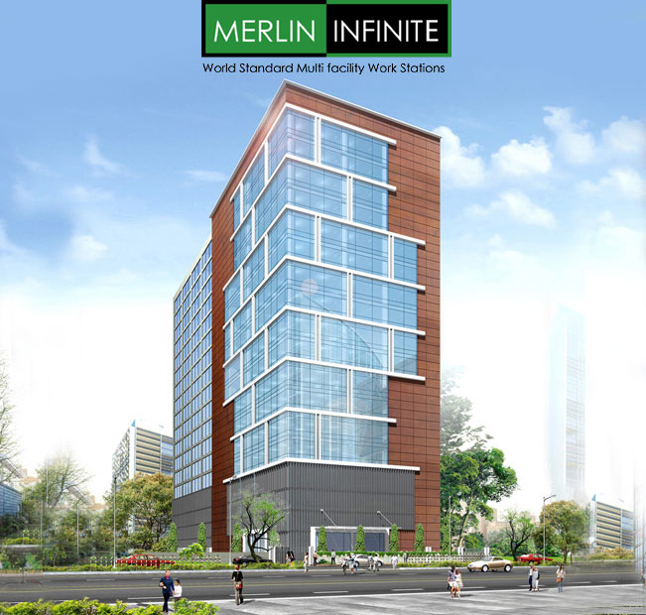
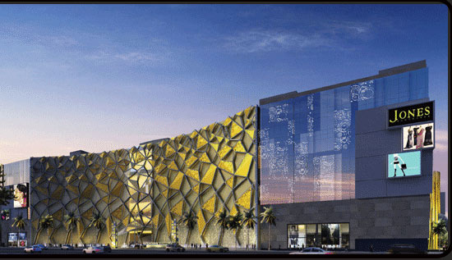
LATEST WINS
TCS IT PARK , RAJARHAT, 6000TR
MAGNACON INFINITY, 2300 TR
MERLIN INFINITE, 1300 TR
QUEST MALL, 2720 TR

Slide 11


Thank You

