Slide 1


@PFX
VPY %
522 +4%
62 +4%
@PFX
VPY %
186 +3%
27 +4%
THIS IS
CARRIER
CF % NI = 21%
CF % NI = 100%
INSPIRING CONFIDENCE

Slide 2

@PFX
VPY %
522 +4%
62 +4%
Confidence drives us.
@PFX
VPY %
186 +3%
27 +4%
Our systems free people to be productive in the harshest climates. When new challenges stand in the way of progress, our innovations help people move forward: filling buildings and homes with healthy, clean air; detecting and putting out fires; keeping people safe and secure. In times of great uncertainty, we make sure foods and lifesaving medicines stay cold and fresh until they reach those who need them most.
At Carrier, we’ll keep bringing you more powerful, sustainable solutions. Together, we can build a
brighter future with confidence.
CF % NI = 21%
CF % NI = 100%
Notes:
Confidence drives us.
Our systems free people to be productive in the harshest climates. When new challenges stand in the way of progress, our innovations help people move forward: filling buildings and homes with healthy, clean air; detecting and putting out fires; keeping people safe and secure. In times of great uncertainty, we make sure foods and lifesaving medicines stay cold and fresh until they reach those who need them most.
At Carrier, we’ll keep bringing you more powerful, sustainable solutions. Together, we can build a
brighter future with confidence.

Slide 3



@PFX
VPY %
522 +4%
62 +4%
@PFX
VPY %
186 +3%
27 +4%
SOLUTIONS
THAT MATTER.
CONFIDENCE
THAT INSPIRES.
Carrier is the leading global provider of healthy, safe and sustainable building and cold chain solutions with a world-class, diverse workforce. With more than a century of expertise, we drive innovation while putting our customers first, helping protect our planet, and inspiring and empowering our people. Through our performance-driven culture, we are driving shareowner value by growing sales and investing strategically to strengthen our position in the markets we serve.
CF % NI = 21%
CF % NI = 100%
Notes:
Carrier is the leading global provider of healthy, safe and sustainable building and cold chain solutions with a world-class, diverse workforce.
We create SOLUTIONS THAT MATTER for people and our planet.
With more than a century of expertise, we drive innovation and INSPIRE CONFIDENCE while putting our customers first, helping protect our planet and empowering our people.
Through our performance-driven culture, we are driving shareowner value by growing sales and investing strategically to strengthen our position in the markets we serve.
(Source: Carrier Fact Sheet)

Slide 4








Our Business
2020 Net Sales Breakdown
Americas
EMEA
Asia Pacific
55%
30%
15%
Net sales
by region
53%
19%
28%
New Equipment
Service &
Aftermarket
72%
28%
HVAC
COMMERCIAL & RESIDENTIAL
$9.5B
Net sales
REFRIGERATION
TRANSPORT & COMMERCIAL
$3.3B
Net sales
FIRE & SECURITY
PRODUCTS & FIELD
$5.0B
Net sales
Net sales
Mix
$17.5B
~56,000
80+
100+
2020 NET SALES
EMPLOYEES
BRANDS
NEW PRODUCTS
for the 6th consecutive year
Proprietary and Confidential
12/31/2021
Notes:
For over a century, we have been developing innovative products and services that have changed the way people live and work.
Our drive for innovation continues today with a renewed focus on creating solutions that will change the world for the better.
We keep customers at the center of every product and service we offer and we act quickly to exceed their expectations.
At Carrier, we see possibilities in everything.
(Sources: Carrier Fact Sheet, Carrier Annual Report)

Slide 5
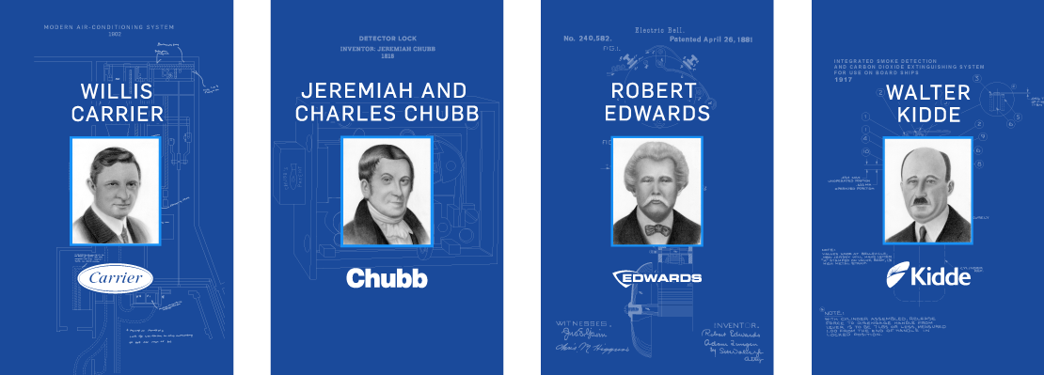
A Leading Legacy
@PFX
VPY %
522 +4%
62 +4%
Carrier was built on a legacy of innovation – beginning with our founders. We are innovators at heart and inventors by heritage. From the start, we’ve led in pioneering new technologies and in enabling entirely new industries that have changed the world. Today, building on our history of firsts, we’re boldly advancing the industries we created to make a difference in people’s lives.
@PFX
VPY %
186 +3%
27 +4%
CF % NI = 21%
CF % NI = 100%
Notes:
We have a proud history of pioneering innovation at Carrier. The legacies of our founders have transformed industries and shaped our great companies into what they are today.
Examples include:
Charles and Jeremiah Chubb patented the first detector lock in 1818;
Robert Edwards’ patent of the first electric alarm bell in 1881;
Willis Carrier’s development of the first modern air conditioning system in 1902; and
The founding of the Walter Kidde Company in 1917, and later production of the first integrated smoke detection and carbon dioxide extinguishing system for use on ships.
We continue to uphold this tradition and have a large portfolio of industry-leading solutions.
(Source: Corporate website)

Slide 6


















Our Industry-Leading Brands
@PFX
VPY %
522 +4%
62 +4%
@PFX
VPY %
186 +3%
27 +4%
CF % NI = 21%
CF % NI = 100%
Notes:
Our industry-leading brands offer customers innovative products, dedicated services and efficient technologies; and include Carrier, Kidde, Edwards and Chubb.
We also provide refrigeration solutions – from brands like Carrier Transicold – that preserve the freshness and quality of perishables for the transport, food retail and food service industries. These technologies help extend the world’s food supply, eliminate food waste and ensure public safety.
And we also have solutions for the residential segment – namely heating, cooling, fire safety and security.
Carrier is our connecting foundation – helping us build awareness of our building solutions portfolio.

Slide 7
Carrier has long been the industry leader in
healthy, safe and sustainable buildings.
Through our Healthy Buildings Program, we help optimize built environments in ways that improve operational efficiency and positively impact occupants – from helping to ensure physical safety and security to improving health, productivity and
cognitive performance.
Today, we are uniquely positioned to provide healthy building solutions through our expertise, global footprint and rapid innovation capabilities. We employ a lifecycle approach to address nearly all aspects of buildings, with an industry-leading portfolio of advanced equipment, services and automation offerings covering HVAC and Fire & Security.
EXPERTISE
Carrier’s approach to healthy buildings
OPTIMIZATION
ASSESSMENT &
IMPLEMENTATION
Notes:
At Carrier, we recognize the potential for indoor environments to help shape a healthier future. Through our Healthy Buildings Program, we help optimize built environments in ways that improve operational efficiency and positively impact occupants – from helping to ensure physical safety and security to improving health, productivity and cognitive performance.
We are uniquely positioned to provide healthy building solutions through our expertise, global footprint and rapid innovation capabilities. We employ a lifecycle approach to address nearly all aspects of buildings, with an industry-leading portfolio of advanced equipment, services and automation offerings covering HVAC and Fire & Security.
OPTIONAL:
Carrier has long been an industry leader in healthy, safe and sustainable buildings. We were a founding member of both the U.S. Green Building Council and the International WELL Building Institute, and have partnered with leading researchers and organizations to explore the impact of built environments.
Across a range of building types, we help improve indoor air quality, help detect and prevent fires, and enable touchless interactions. Our solutions meet the unique needs of each industry, including commercial buildings, healthcare, hospitality, education, retail and marine.
Carrier is leading the way in helping customers approach building environments with a focus on what matters most – the people inside.
(Source: Carrier Proxy Statement 2021)

Slide 8
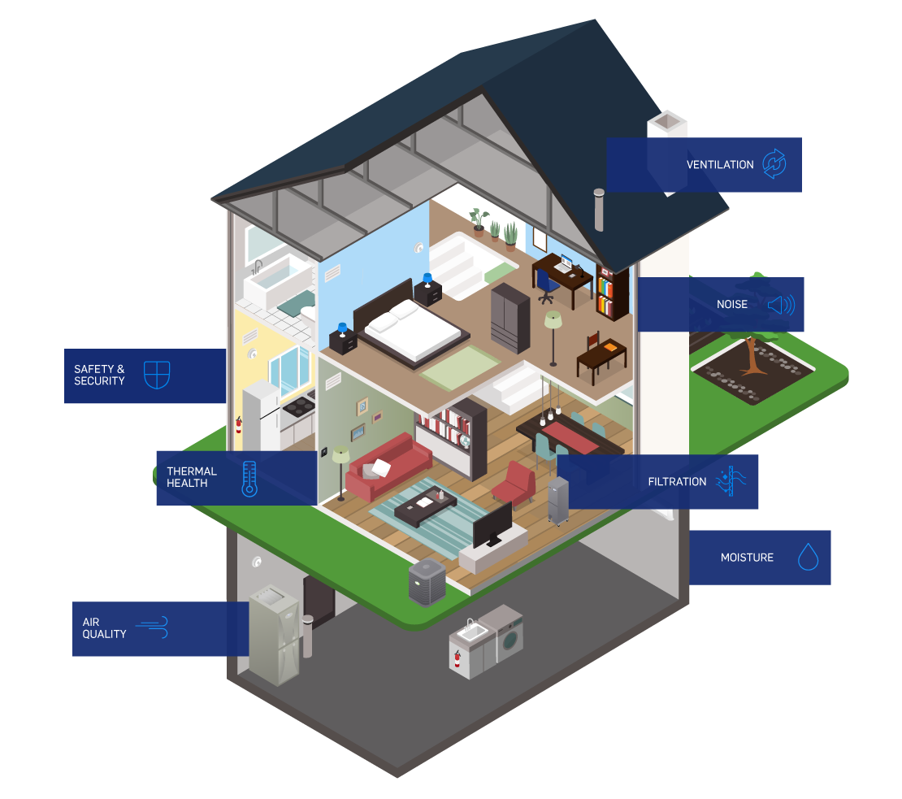
@PFX
VPY %
522 +4%
62 +4%
@PFX
VPY %
186 +3%
27 +4%
In 2020, as part of our Healthy Buildings Program, Carrier launched Healthy Homes –
a suite of targeted solutions that can help improve the overall health of homes and the people inside.
Carrier products make homes more comfortable and help make the air inside fresher and cleaner. Fire safety products can help protect people, pets and structures in the event of a fire.
CF % NI = 21%
CF % NI = 100%
Notes:
In 2020, as part of our Healthy Buildings Program, Carrier launched Healthy Homes – a suite of targeted solutions that can help improve the overall health of homes and the people inside.
As people spend more time at home than ever before, it is important to ensure living and working spaces are healthy because homes impact our health. This includes the air we breathe and the comfort of feeling secure in our spaces. Homes have become the new office, classroom, gym and restaurant, elevating the importance of indoor air quality and home safety.
(Source: Carrier Proxy Statement 2021)

Slide 9
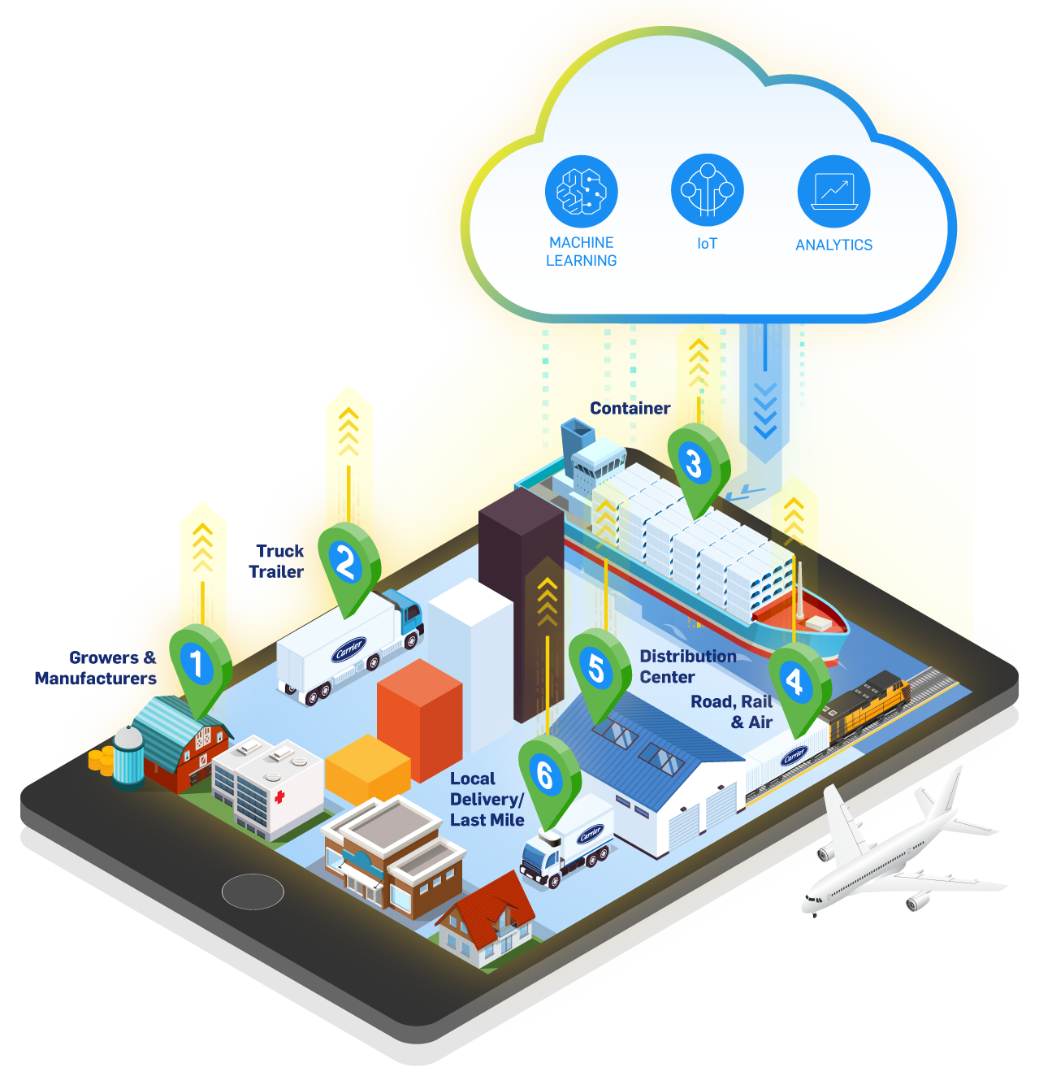

The world needs a more connected cold chain for greater visibility and control. Carrier is committed
to rapid innovation, partnerships and thought leadership to help preserve, protect and extend
the supply of food, medicine and vaccines around the planet.
In 2020, we launched the Healthy, Safe, Sustainable Cold Chain Program to help customers meet rapidly evolving supply chain demands and make their cold chain activities more effective.
We are collaborating with Amazon Web Services to develop Lynx, Carrier’s proprietary cloud-enabled platform with machine learning to better address long-standing cold chain challenges.
Notes:
The need has never been greater for safe and sustainable cold chain technologies.
Carrier is committed to rapid innovation, partnerships and thought leadership to help preserve, protect and extend the supply of food, medicine and vaccines around the planet.
The cold chain provides safe, efficient, uninterrupted transport and storage of perishable goods from producers to consumers around the world. More than one-third of all food produced is wasted every year, resulting in an estimated 4.4 gigatons of greenhouse gas emissions. In addition, vaccines require precise conditions for safe transport.
In 2020, we launched the Healthy, Safe, Sustainable Cold Chain Program to help customers meet rapidly evolving supply chain demands and make their cold chain activities more effective.
Amazon Web Services has become a collaborator for digital innovation. Carrier and AWS are developing new market offerings like Lynx, Carrier’s proprietary intelligent ecosystem that will help optimize the safe and sustainable transport of perishable goods and medicine across the cold chain.
(Source: Carrier Annual Report 2020, Carrier Proxy Statement 2021)

Slide 10
















Our 2030 Sustainability Goals
@PFX
VPY %
522 +4%
62 +4%
@PFX
VPY %
186 +3%
27 +4%
OUR PLANET
OUR PEOPLE
OUR COMMUNITIES
Invest over $2B to develop healthy, safe and sustainable building and cold chain solutions that incorporate sustainable design principles and reduce life-cycle impacts.
Achieve carbon-neutral operations.
Reduce energy intensity by 10% across our operations.
Achieve water neutrality in our operations, prioritizing water-scarce locations.
Deliver zero waste to landfill from manufacturing locations.
Establish a responsible supply chain program and assess key factory suppliers against program criteria.
Exceed benchmark employee engagement.
Achieve gender parity in senior leadership roles.
Maintain world-class safety metrics.
Achieve a diverse workforce that represents the communities in which we live and work.
Foster the growth of employee resource groups to drive social impact.
Positively impact communities through enabling access to safe and healthy indoor environments, alleviating hunger and food waste, and volunteering our time and talent
Invest in STEM education programs that promote diversity and inclusion.
Promote sustainability through education, partnerships and climate resiliency programs.
CF % NI = 21%
CF % NI = 100%
REDUCE OUR CUSTOMERS’ CARBON FOOTPRINTBY MORE THAN
1 GIGATON.
Notes:
Building on our vision to create solutions that matter for people and our planet, Carrier announced our 2030 environmental, social and governance (ESG) goals.
We are targeting carbon neutrality across our operations by 2030 and aiming to reduce our customers’ carbon footprint by more than 1 gigaton over the same period. This will be supported by planned investments of more than $2 billion over the next 10 years toward the development of healthier, safer and more sustainable solutions.
(Source: Carrier Annual Report 2020)

Slide 11
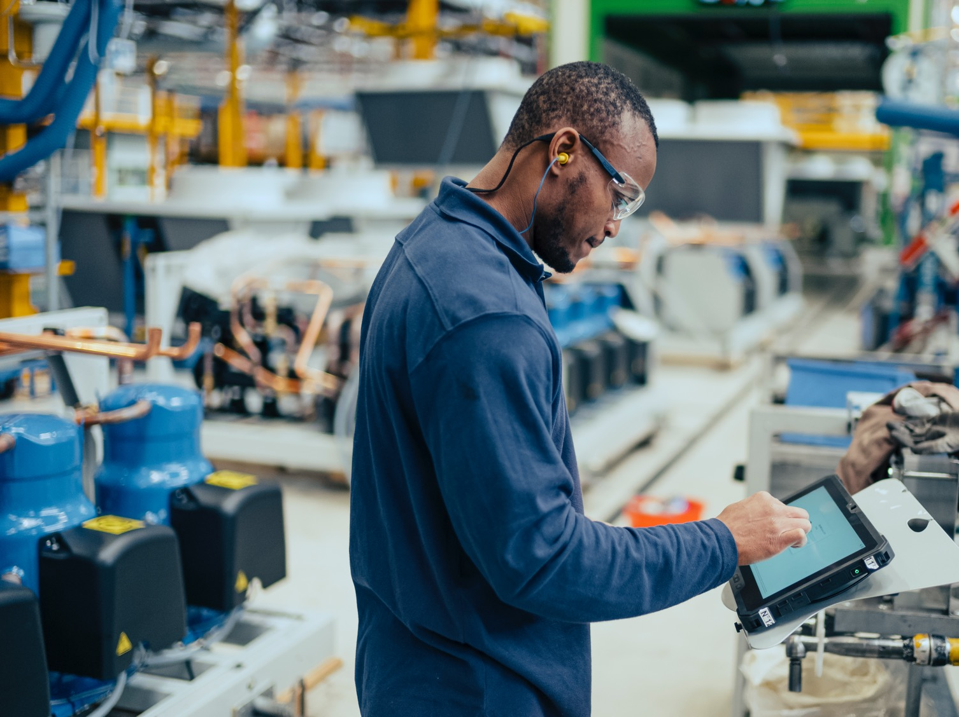
Our People & Culture
@PFX
VPY %
522 +4%
62 +4%
@PFX
VPY %
186 +3%
27 +4%
At Carrier, our greatest strength is the
diversity of our global employees and their ideas. We are a company of innovators and problem-solvers who are united by The Carrier Way – our purpose, values and culture.
As an employer of choice, we strive to provide a great place to work that attracts, develops and retains the best talent, promotes employee engagement and inclusion, and fosters teamwork, which ultimately drives innovation for the benefit of our customers.
CF % NI = 21%
CF % NI = 100%
Notes:
Our greatest strength is the diversity of our global employees and their ideas. We are a company of innovators and problem-solvers who are united by The Carrier Way – our purpose, values and culture.
We strive to provide a great place to work that attracts, develops and retains the best talent, promotes employee engagement and inclusion, and fosters teamwork, which ultimately drives innovation for the benefit of our customers.
(Source: Carrier Annual Report 2020)

Slide 12

VISION
Our aspiration; why we come to work every day.
Creating solutions that matter for people and our planet.
VALUES
Our absolutes; always do the right thing.
Respect Integrity Inclusion Innovation Excellence
CULTURE
Our behaviors; how we work and win together, while never compromising our values.
Passion for Customers
We win when our customers win.
Play to Win
We strive to be #1 in everything we do.
Choose Speed
We focus and move with a bias for action.
Achieve Results
We perform, with integrity.
Dare to Disrupt
We innovate and pursue sustainable solutions.
Build Best Teams
We develop diverse teams, and empower to move faster.
Notes:
The Carrier Way summarizes our vision, values and the behaviors that will contribute to the culture we need today and into the future. While it starts with our Executive Leadership Team, and their commitment to leading by example, all of us can lead where we are and start to model the behaviors that will move us closer to the culture we aspire to have.
While our vision is ambitious and aspirational, it shows our intention to create solutions that matter for people and our planet. Values and culture serve different purposes, all intended to help us achieve the vision.
Values underscore the things we believe are important about the ways in which we conduct ourselves during the course of work. Respect, integrity, inclusion, innovation and excellence embody every aspect of who we are and how we aspire evolve our culture.
And, culture is influenced and shaped by behaviors.

Slide 13
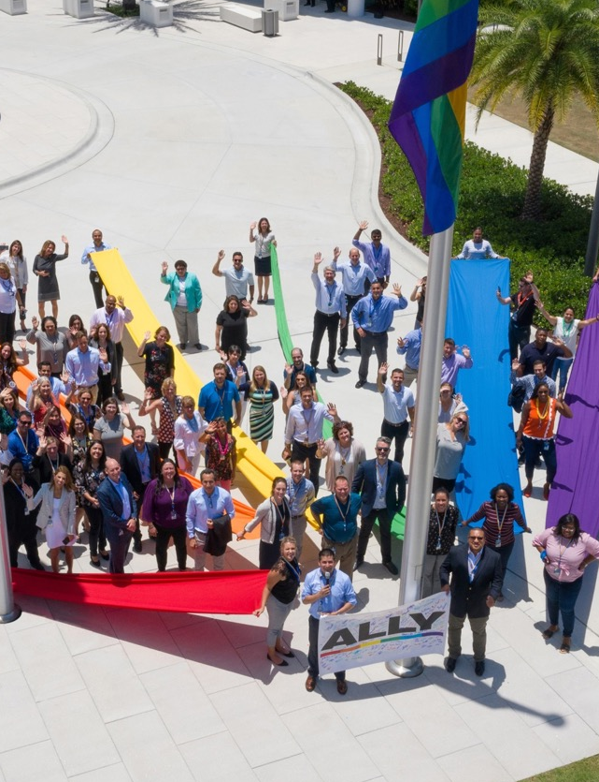

Diversity & Inclusion Strategy
Reduce the gap
Develop
and sponsor
Drive inclusion
We continue to build a diverse team of talented and high-performing employees at all levels of the company. In 2020, we launched a more focused diversity and inclusion strategy to drive meaningful change that consists of four tenets, with associated actions and initiatives: Reduce the Gap, Develop & Sponsor, Drive Inclusion and Lean Forward.
Lean forward
Notes:
Aligned with our approach to build best teams, is our commitment to our diversity and inclusion strategy, which includes four core tenets.
Reduce the Gap. We are very focused on reducing the gap by recruiting more diverse talent to Carrier, starting with expanding our engagement with historically black colleges and universities (HBCUs). Our company continues to invest in long-term, strategic collaborations with organizations like the National Society of Black Engineers, where we are a member of the board of corporate affiliates. Carrier also actively participates in annual recruiting and collaboration efforts with the Society of Women Engineers and the Society of Hispanic Professional Engineers to progress diverse talent faster in the organization.
Develop & Sponsor. Developing and sponsoring is critical to our journey. Through our programs like ELEVATE: Women in Leadership and the launch of ELEVATE: Blacks in Leadership, we offer customized, immersive development and learning opportunities to prepare employees to thrive and succeed.
Drive Inclusion. The key to inclusion is to listen and learn, and to focus on education and training of leaders and employees across the organization. Through Employee Resource Groups, fireside chats, listening sessions and unconscious bias training we are focused on driving a culture of inclusion throughout the company. As always, there is zero tolerance for any form of discrimination, and we provide employees anonymous reporting channels to report incidents of racism or discrimination.
In its first year as a fully independent, publicly traded company, Carrier has achieved a perfect score of 100 points on the Human Rights Campaign Foundation’s 2021 Corporate Equality Index, which measures corporate policies and practices related to LGBTQ workplace equality. The score also earns Carrier a “Best Place to Work for LGBTQ Equality” designation.
Lean Forward. We celebrate our diversity and communicate authentically and transparently about our progress toward inclusion, and continuously look for new ideas to make Carrier a truly inclusive workforce.
During Women’s History Month, Carrier’s Women’s Empowerment (WE@Carrier) employee resource group hosted more than 25 events in 22 countries, with over 4,000 employees attending. The programs were designed to accelerate women’s leadership and empower them to address unique workplace challenges.
Carrier Black Alliance (CBA), an employee resource group dedicated to attracting, retaining, inspiring and reinforcing the value of Black employees at Carrier, organized a full month of activities for Black History Month.
Each of these tenets underscore elements of the business drivers that The Carrier Way will influence for our company.
(Sources: Annual Report 2020, press releases)
https://www.corporate.carrier.com/news/news-articles/carrier_achieves_perfect_score_in_corporate_equality_index.html
https://www.corporate.carrier.com/news/stories/stories-articles/listening-mentoring-and-leaning-in-black-history-month-at-carrier.html
https://www.corporate.carrier.com/news/stories/stories-articles/choosing-to-challenge-womens-history-month-at-carrier.html

Slide 14


Our Communities
185
Civic, cultural, economic and social welfare organizations supported around the world in 2020
@PFX
VPY %
522 +4%
62 +4%
@PFX
VPY %
186 +3%
27 +4%
$7M+
Invested in our communities through cash and in-kind donations in 2020
~$800K
Donated in 2020 through the Carrier Employee Matching Gifts Program, a dollar-for-dollar charitable donation matching program
8
Food banks benefited from our grants to Feeding America to help distribute over 20 million pounds of food to those in need in 2020
CF % NI = 21%
CF % NI = 100%
$3M
Three-year donation to support The Nature Conservancy’s
Build Healthy Cities initiative
1.6M+
Smoke and carbon monoxide alarms donated to fire departments since 2002 to help make underserved communities safer through Kidde’s Operation Save a Life program
Notes:
Decades of leadership in sustainability have guided Carrier to the forefront of healthy buildings, healthy homes and a more connected cold chain. Throughout our global operations, we are reducing our environmental footprint and making investments that have a positive impact on society.
In 2020, Carrier supported more than 185 civic, cultural, economic and social welfare organizations around the world. We invested over $7 million in our communities through cash and in-kind donations, including nearly $800,000 through the Carrier Employee Matching Gifts Program, a dollar-for-dollar charitable donation matching program.
As millions of people struggle with food insecurity, our donations to Feeding America benefited eight food banks across three states to help distribute over 20 million pounds of food to those in need in 2020. Our U.S. employees also hosted local food drives that helped provide over 375,000 meals across seven food banks.
During the year, we announced a $3 million, three-year donation to The Nature Conservancy, a global organization working to create a world where people and nature can thrive together.
Through its Operation Save a Life program, Kidde donated nearly 45,000 alarms throughout 16 cities across the United States in 2020. Since 2002, Kidde has donated more than 1.6 million smoke and carbon monoxide alarms to fire departments to help make underserved communities safer.
(Source: Carrier Annual Report 2020)

Slide 15
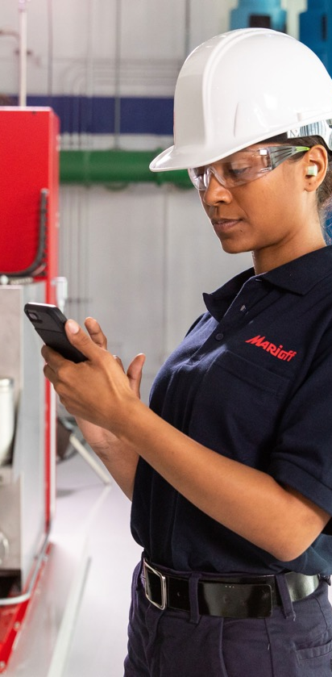

Services
Service Tiers
Core
Basic plan
Customers maintain equipment
Carrier provides on-demand expert service
BluEdge is an enterprise-wide service
and aftermarket offering designed to provide customers with superior service throughout the product lifecycle, with digitally enabled differentiation.
Through a deep understanding of
customer needs and investments in connected equipment and digital service solutions, BluEdge will help achieve enhanced equipment efficiency and performance – key components of our healthy, safe and sustainable building
and cold chain programs.
Enhance
Value-added options
e.g., multiyear service agreement, preventive maintenance or remote monitoring
Elite
Comprehensive service offering
Unmatched customer support and cutting-edge technology to optimize performance, maximize uptime and minimize cost
Notes:
Services are a major priority for Carrier. We are committed to bringing differentiated parts and service solutions to our customers across the entire product lifecycle. The introduction of our BluEdge global service platform takes that commitment to the next level.
Our new BluEdge platform leverages our history of innovation and our deep expertise as an original equipment manufacturer. The platform offers a tiered suite of services across our HVAC, Refrigeration and Fire & Security segments.
Through a deep understanding of customer needs and investments in connected equipment and digital service solutions, BluEdge will help achieve enhanced equipment efficiency and performance – key components of our healthy, safe and sustainable building and cold chain programs.
The BluEdge service platform uses analytics to decipher data, extract insights and implement solutions before issues arise. The platform complements our existing network of service providers. Highly trained Carrier technicians and support teams are located across the globe, and our customers can count on our 22 aftermarket fulfillment centers for their parts and service needs.
(Source: Carrier Annual Report 2020)
OPTIONAL:
We have three service tiers:
Core:
For customers that want to maintain their equipment on their own (but may occasionally call on Carrier for on-demand expert service) or want to sign up for our most basic plans.
Enhance:
Designed for customers who want to sign up for a service plan that includes more value-added options, such as a multi-year service agreement, preventive maintenance, or remote monitoring.
Elite:
This is the most comprehensive service offering for each of our businesses, and it has one purpose: to provide customers with complete peace of mind. We will use unmatched customer support, coupled with cutting edge technology to optimize performance, maximize uptime, and minimize cost.
(Source: https://www.corporate.carrier.com/our-company/BluEdge/)

Slide 16

Digital
Digital is central to Carrier’s growth strategy. Digital solutions are empowering our employees, enhancing our experiences and enabling top-line growth opportunities.
We are implementing innovative digital capabilities across our business segments to help differentiate our products and services.
Notes:
Carrier is implementing innovative digital capabilities across our business segments to help differentiate our products and services.
Amazon Web Services is our new preferred cloud provider. Product teams are deriving insights from data and unlocking customer value by leveraging AWS services for connectivity, artificial intelligence and machine learning.
At Carrier, we are developing connected devices that improve user experiences and smooth service delivery. Our new proprietary platform Carrier IO will enable connectivity throughout the enterprise. Carrier IO will provide turnkey services to connect equipment and accelerate product development across our portfolio.
In 2020, we implemented new and enhanced e-commerce capabilities and online shop-and-buy offerings to help drive online sales and create an easier, more convenient and engaging customer experience.
(Source: Carrier Annual Report 2020)

Slide 17
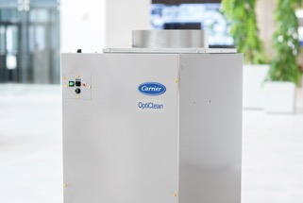

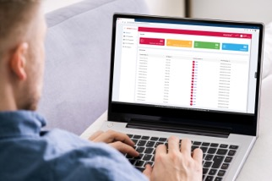



Innovation
@PFX
VPY %
522 +4%
62 +4%
We create solutions that customers can count on to help protect people and property across the globe, enhance comfort and indoor air quality in all types of buildings and homes, and provide the conditions needed to ensure that food and medicine safely reach billions of people around the planet.
@PFX
VPY %
186 +3%
27 +4%
CF % NI = 21%
CF % NI = 100%
The OptiClean Dual-Mode
Air Scrubber & Negative Air
Machine was named as one of TIME’s 100 Best Inventions of 2020.
Carrier and Amazon Web Services Inc. began a multiyear transformative alliance to develop Carrier’s new Lynx digital platform to help customers reduce food and medicine loss, optimize supply chain logistics and enhance environmental sustainability.
Kidde Fire Systems launched the
IntelliSite Remote Monitoring System that offers real-time information access to fire suppression systems across multiple locations from a computer, tablet or smartphone.
Notes:
Carrier has a strong history of innovation across our HVAC, Refrigeration and Fire & Security segments. We are committed to accelerating the development of smart, sustainable and efficient solutions that address our planet’s most complex challenges.
Our engineering team is focused on key strategic themes aligned with Carrier’s growth strategy: sustainability, service and digital solutions – all in support of addressing global megatrends, expanding our current markets and growing in adjacent ones.
In 2020, for the sixth year in a row, we released more than 100 new products. We have approximately 8,000 active patents and pending patent applications worldwide combined, and in the last two years have invested over $800 million in research and development.
In our HVAC segment, the OptiClean Dual-Mode Air Scrubber & Negative Air Machine was named as one of TIME’s 100 Best Inventions of 2020.
In our Refrigeration segment, Carrier and Amazon Web Services Inc. began a multiyear transformative alliance to develop Carrier’s new Lynx digital platform to help customers reduce food and medicine loss, optimize supply chain logistics and enhance environmental sustainability.
And in our Fire & Security segment, Kidde Fire Systems launched the IntelliSite Remote Monitoring System that offers real-time information access to fire suppression systems across multiple locations from a computer, tablet or smartphone.
(Source: Carrier Annual Report 2020, Carrier Proxy Statement 2021)

Slide 18
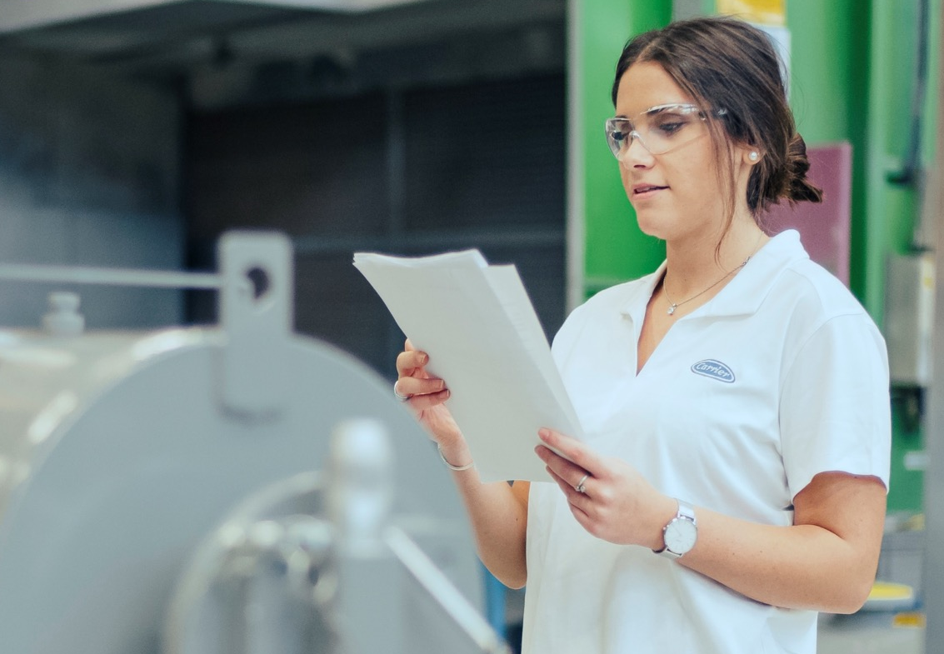

Operations
@PFX
VPY %
522 +4%
62 +4%
@PFX
VPY %
186 +3%
27 +4%
Carrier Excellence is our continuous improvement framework that drives operational excellence across our company, enhances the customer experience to enable growth, engages employees to continuously improve processes and cultivates a proactive, positive culture.
CF % NI = 21%
CF % NI = 100%
Notes:
Carrier Excellence is our continuous improvement framework that drives operational excellence across our company, enhances the customer experience to enable growth, engages employees to continuously improve processes and cultivates a proactive, positive culture.
We focus on outstanding performance through:
Enhancing the customer experience
Driving value to our shareholders
Delivering best-in-class performance
Engaging employees to continuously improve our processes
Innovating sustainable solutions for the future
Carrier Excellence uses a proven set of tools to foster competency development and a continuous improvement culture.
We are committed to consistently delivering value to our customers, improving our employees' experience and meeting our financial commitments to our shareholders.
(Source: corporate website)
(Source: Carrier Annual Report 2020)

Slide 19

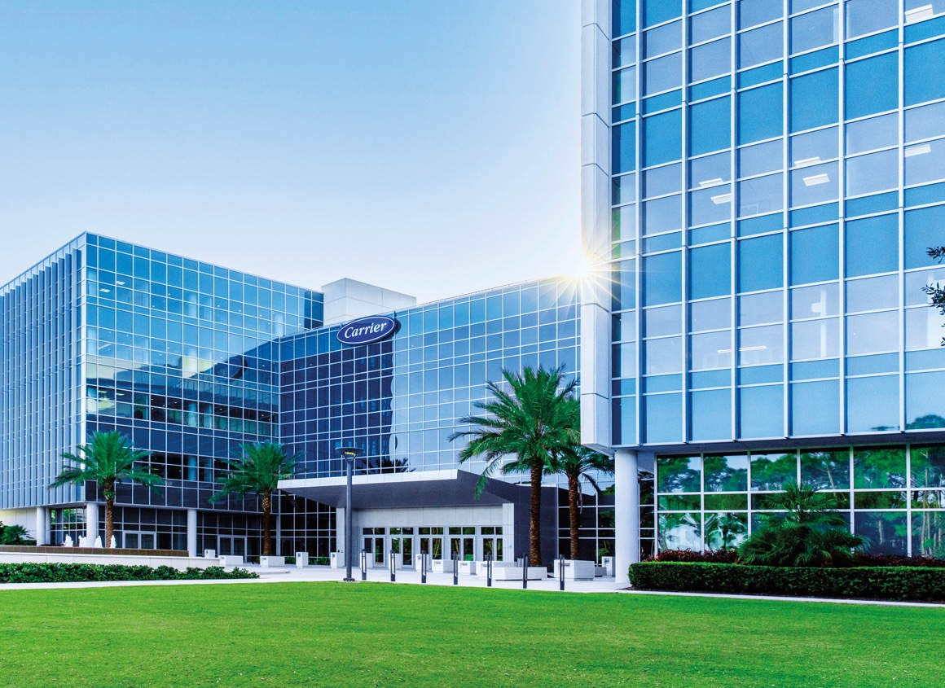

Putting
Innovation
Into Practice
@PFX
VPY %
522 +4%
62 +4%
@PFX
VPY %
186 +3%
27 +4%
The Center for Intelligent Buildings is a
first-of-its-kind, intelligent and sustainable
innovation and technology center, featuring
Carrier solutions and interactive displays.
The building provides a healthy and productive environment for employees and visitors, delivers an enhanced ventilation rate that is at least 30% above the ASHRAE 62.1 standard, and enables touchless access for a more personalized, safe and secure experience.
LEED® Platinum Certification
The Center for Intelligent Buildings became the first
commercial building in the state of Florida to earn LEED v4
Platinum certification from the U.S. Green Building Council.
CF % NI = 21%
CF % NI = 100%
Notes:
In 2016 we broke ground on the Center for Intelligent Buildings, a state-of-the-art innovation and technology center and building showcase in the heart of the high-technology center of Palm Beach Gardens, Florida, and officially opened the facility in April 2018.
The Center for Intelligent Buildings is a first-of-its-kind, intelligent and sustainable innovation and technology center that showcases Carrier products and integrated systems.
The building features solutions and interactive displays from Carrier brands such as Automated Logic, Chubb, Edwards, Kidde and LenelS2.
The Center for Intelligent Buildings became the first commercial building in the state of Florida to earn LEED Platinum certification from the U.S. Green Building Council, under the version 4 green building program and serves as the global corporate headquarters for Carrier.
Carrier remains a leader in the green building movement, and this dovetails with our commitment to sustainability.
(Source: CIB claim confirmed by Luke Dorna)

Slide 20

SOLUTIONS
THAT MATTER.
CONFIDENCE
THAT INSPIRES.
Notes:
At Carrier, we show up every day knowing that the work we do matters.
As the world leader in healthy, safe and sustainable building and cold chain solutions, we create solutions that matter for people and our planet. Because at Carrier, that’s what matters – and it always will.
We are confident that our best days are ahead.
(Source: Annual Report Shareowners Letter)

Slide 21
@PFX
VPY %
522 +4%
62 +4%
@PFX
VPY %
186 +3%
27 +4%
CF % NI = 21%
CF % NI = 100%
©2021 Carrier. All Rights Reserved.
Notes:
(Presentation last updated 04/19/2021)

